Slide 1
EE5907/EE5027 Week 2: Probabilistic Estimation + Conjugate Priors
BT Thomas Yeo
National University of Singapore

Slide 2
Last Week Recap
Discrete & continuous random variables
Probability distribution function (pdf) / probability mass function (pmf)
Joint distributions of N random variables
Marginalization / Law of Total Probability
Conditional probability
Bayes’ Rule
Independence, Conditional Independence
Expectation, conditional expectation
Notes:
Now that we have reviewed basic probability, let’s go on to the real meat of the class.

Slide 3
Questions?
Notes:
Any questions before I continue?

Slide 4
Key Goal in Machine Learning: Signal Detection or Estimation
Given observation x, estimate y by computing y* = d(x)
”d” stands for “detection”
Notes:
One key goal in machine learning is signal detection or estimation.
Basically given observation x, we want to estimate y as a function of observation x.
This is very important because in the real world, we often have to take different action depending on what we think y is.

Slide 5
Key Goal in Machine Learning: Signal Detection or Estimation
Given observation x, estimate y by computing y* = d(x)
”d” stands for “detection”
In real world, have to take action based on what we think y is
x is cancer test results & y is whether patient has cancer
x is radar signal & y is whether there is an incoming missile
x is facebook photo & y is name of person in photo
Notes:
For example, x might be cancer test results, and y is whether the patient has cancer or not.
x might be radar signal and y is whether there is an incoming missile.
x might be a facebook photo, and y is whether john, alice or bob is in the photo.

Slide 6
Key Goal in Machine Learning: Signal Detection or Estimation
Given observation x, estimate y by computing y* = d(x)
”d” stands for “detection”
In real world, have to take action based on what we think y is
x is cancer test results & y is whether patient has cancer
x is radar signal & y is whether there is an incoming missile
x is facebook photo & y is name of person in photo
Obviously “detection” does not need to be probabilistic, but the world is uncertain (e.g., measuring instruments have noise, unexpected things might happen)
Therefore, we will focus on probabilistic signal detection or estimation
Notes:
Obviously “detection” or ”estimation” does not need to be probabilistic, but the world is uncertain. For example, our measuring instruments have noise, or unexpected things might happen in the world.
Therefore, we will focus on probabilistic signal detection or probabilistic estimation

Slide 7
Maximum-A-Posterior (MAP) and Maximum Likelihood (ML) Estimation
Notes:
I will now introduce two well known probabilistic estimation approaches: MAP and ML estimation

Slide 8
Digression: argmax and argmin
Notes:
But first, let me explain argmax and argmin.
Argmax over x of the function f(x) is the value of x for which f(x) is the largest.

Slide 9
Digression: argmax and argmin
Notes:
Argmin over x of f(x) is the value of x for which f(x) is the smallest.

Slide 10
Digression: argmax and argmin
Notes:
For example, suppose f(x) is equal to ABSOLUTE value of sin of 4 x SQUARE + x TIMES e to the NEGATIVE x + x SQUARE when x is between -0.95 and 0.95.
And f(x) is 0 otherwise.
Just by looking at this function, can anyone tell me the values of x for which f(x) is the highest and for which f(x) is the lowest?
<PAUSE>

Slide 11
Digression: argmax and argmin
Notes:
Just by looking at the function, it’s not easy to know what’s the maximum and minimum right?
In general, it’s much easier to compute f(x) for a specific value of x than to find the value of x corresponding to the maximum or minimum of f(x).

Slide 12
Digression: argmax and argmin
Global Maximum
Global Minima
Global Minima
Notes:
We can plot f(x), which looks something like this.
The maximum of the function occurs at x equal to 0.95.
And the minimum of the function occurs for x less than -0.95 and x greater than 0.95. In this case, there are many values of x corresponding to the minimum value of f(x), which is 0. x = -10, x = 20, x = 100 all correspond to f(x) being equal to the minimum value of 0.

Slide 13
Digression: argmax and argmin
Local Maxima/Minima
Global Maximum
Global Minima
Global Minima
Notes:
In real problems, we might not even be able to find the global maximum or minimum of a function, and we might settle for just local maximum and minimum.
For example, these local hills here correspond to local maxima of f(x), and these local valleys here correspond to the local minima of f(x).
<Any questions?>

Slide 14
MAP and ML Estimation
Notes:
Suppose we observe x, and we want to estimate y.
Then in Maximum-A-Posteriori or MAP estimation, our estimate of y is the value of y that maximizes the POSTERIOR probability of y GIVEN x.
This is what the argmax notation means. For a given value of x, we can think of p(y | x) as a function of y. So we want to find the value of y that maximizes this function of y.

Slide 15
MAP and ML Estimation
Bayes’ rule
Notes:
We can use Bayes rule to rewrite the posterior as p(y) TIMES p(x | y) DIVIDED by p(x).

Slide 16
MAP and ML Estimation
Bayes’ rule
p(x) not function of y
Notes:
Because p(x) does not depend on y, we can simply ignore it.
So the MAP estimate of y is the value of y that maximizes the prior probability of y TIMES the likelihood p(x | y).

Slide 17
MAP and ML Estimation
Bayes’ rule
p(x) not function of y
Notes:
For example, suppose Probability of chair given the photograph is 0.6. Probability of human given the photograph is 0.3. Probability of cat given the photograph is 0.1.
Since 0.6 is bigger than 0.3 and 0.1, the MAP estimate of y is the chair.
<PAUSE>

Slide 18
MAP and ML Estimation
Bayes’ rule
p(x) not function of y
Notes:
Now suppose Probability of chair given the photograph is PROPORTIONAL to 1.2. Probability of human given the photograph is PROPORTIONAL to 0.6. Probability of cat given the photograph is PROPORTIONAL to 0.2.
<PAUSE>

Slide 19
MAP and ML Estimation
Bayes’ rule
p(x) not function of y
Notes:
Notice that 1.2+0.6+0.2 is equal to 2, so this is not a valid probability distribution. This is why we use “proportional” sign rather than “equal” sign.
But 1.2 is bigger than 0.6 and 0.2, so the MAP estimate is still the chair.

Slide 20
MAP and ML Estimation
Bayes’ rule
p(x) not function of y
Notes:
If we want to get back the proper distribution, we can simply normalize the probabilities.
Let c be equal to 1.2+0.6+0.2, which is 2.
So Probability of chair given the photograph is equal to 1.2 divided by c, which is equal to 0.6. Probability of human given the photograph is equal to 0.6 divided by c, which is equal to 0.3. Probability of cat given the photograph is equal to 0.2 divided by c, which is equal to 0.1.
<PAUSE>

Slide 21
MAP and ML Estimation
Bayes’ rule
p(x) not function of y
Notes:
Now, let’s consider the special case, where all values of y are equally likely A PRIORI, then p(y) is constant and so we can also drop p(y).
In this scenario, the MAP estimate is the same as finding the value of y that maximizes the likelihood of the observations x given y.
This is called the maximum likelihood estimate.

Slide 22
MAP and ML Estimation
Bayes’ rule
p(x) not function of y
Notes:
In general, ML estimation is computationally easier than MAP estimation, because we do not need to deal with the extra prior term.
We often use ML estimation if the prior is unknown or if we do not feel comfortable assuming priors.

Slide 23
MAP and ML Estimation
Bayes’ rule
p(x) not function of y
Notes:
Furthermore, when the amount of data goes to infinity, the map estimate and the ML estimate will converge to the same thing.

Slide 24
What is hard here?
ML is a special case of MAP, so let’s focus on MAP (for now)
In previous example of chair, human & cat, I gave you p(y | x = photo), but how to get p(y | x = photo) in the first place?
Much of machine learning is about how to choose a model for p(y | x) and how to evaluate/optimize model parameters
Notes:
Since Maximum likelihood is a special case of MAP, let’s focus on MAP for now.
In the previous example of chair human and cat, I gave you the posterior probability.
But how do we get the probabilities in the first place? Much of machine learning is about how to model this posterior probability p(y | x) and once we have settled on the model, how can we evaluate or optimize the model parameters.

Slide 25
Questions?
Notes:
Any questions before I continue?

Slide 26
Two strategies for modeling posterior probability p(y | x): Generative vs Discriminative Models
Notes:
We will now discuss two main strategies for modeling the posterior probability p(y | x)

Slide 27
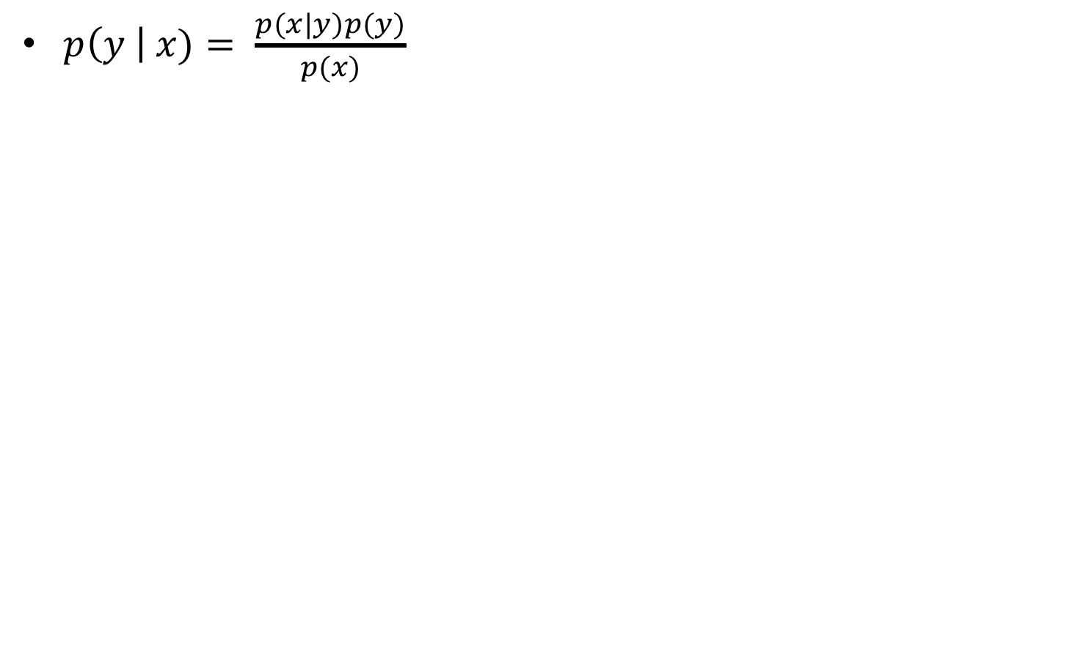
Modeling p(y | x)
$p\left(y \right| x)= \frac{p(x|y)p(y)}{p(x)}$
Notes:
Recall that to get the posterior distribution p(y | x), we can apply Bayes rule, so the posterior p(x|y) is equal to the prior p(y) times the likelihood p(x | y) divided by the evidence p(x)

Slide 28
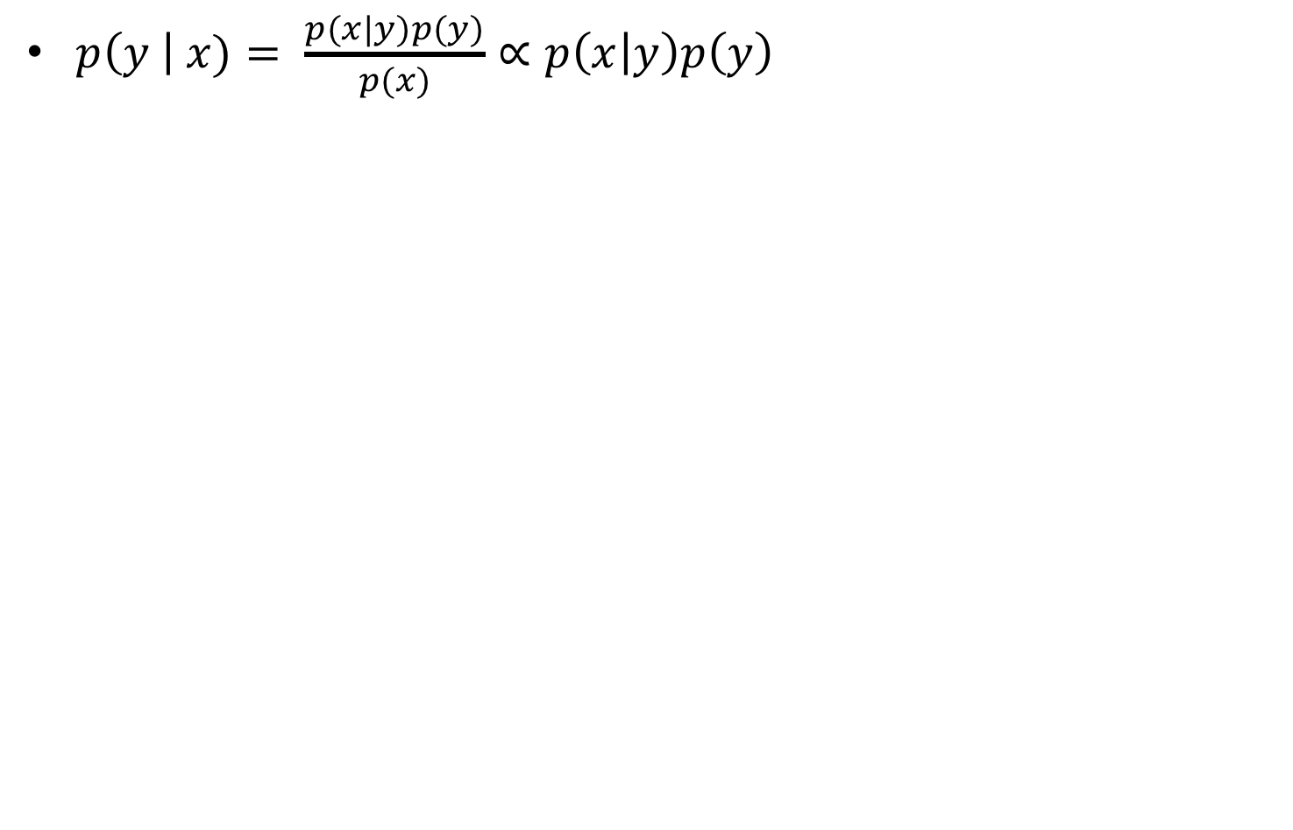
Modeling p(y | x)
$p\left(y \right| x)= \frac{p(x|y)p(y)}{p(x)}∝p\left(x | y\right)p\left(y\right)$
Notes:
As explained previously, the evidence term p(x) does not depend on y, so since we are interested in y, we can simply drop the denominator

Slide 29
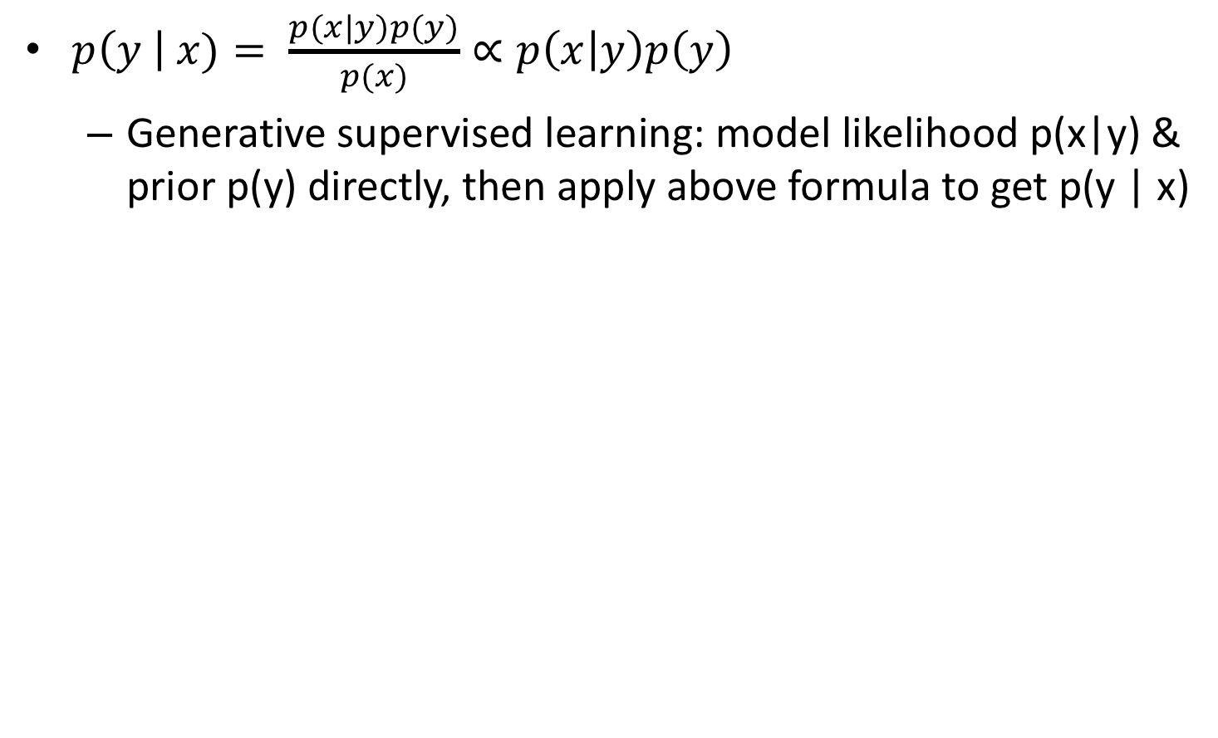
Modeling p(y | x)
$p\left(y \right| x)= \frac{p(x|y)p(y)}{p(x)}∝p\left(x | y\right)p\left(y\right)$
Generative supervised learning: model likelihood p(x|y) & prior p(y) directly, then apply above formula to get p(y | x)
Notes:
So in generative supervised learning, we model the likelihood p(x | y), and the prior p(y).
We can then apply the above formula to get the posterior p(y | x)

Slide 30
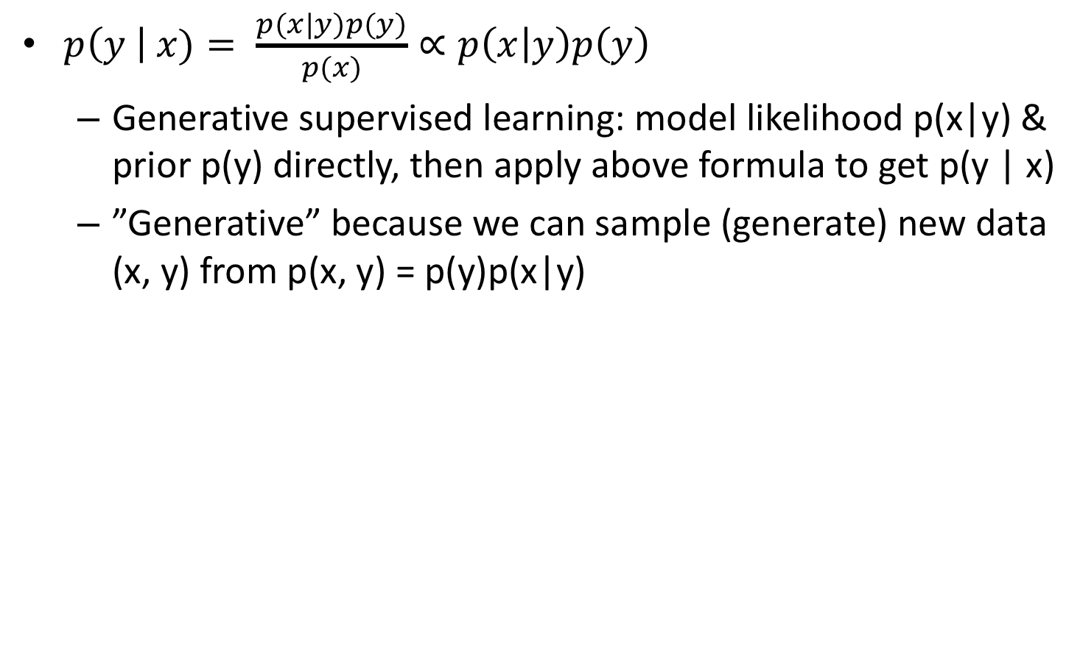
Modeling p(y | x)
$p\left(y \right| x)= \frac{p(x|y)p(y)}{p(x)}∝p\left(x | y\right)p\left(y\right)$
Generative supervised learning: model likelihood p(x|y) & prior p(y) directly, then apply above formula to get p(y | x)
”Generative” because we can sample (generate) new data (x, y) from p(x, y) = p(y)p(x|y)
Notes:
This is called a “generative” model because we can sample (or generate) new data (x, y) from the joint distribution p of x and y, which is equal to the prior times the likelihood.

Slide 31
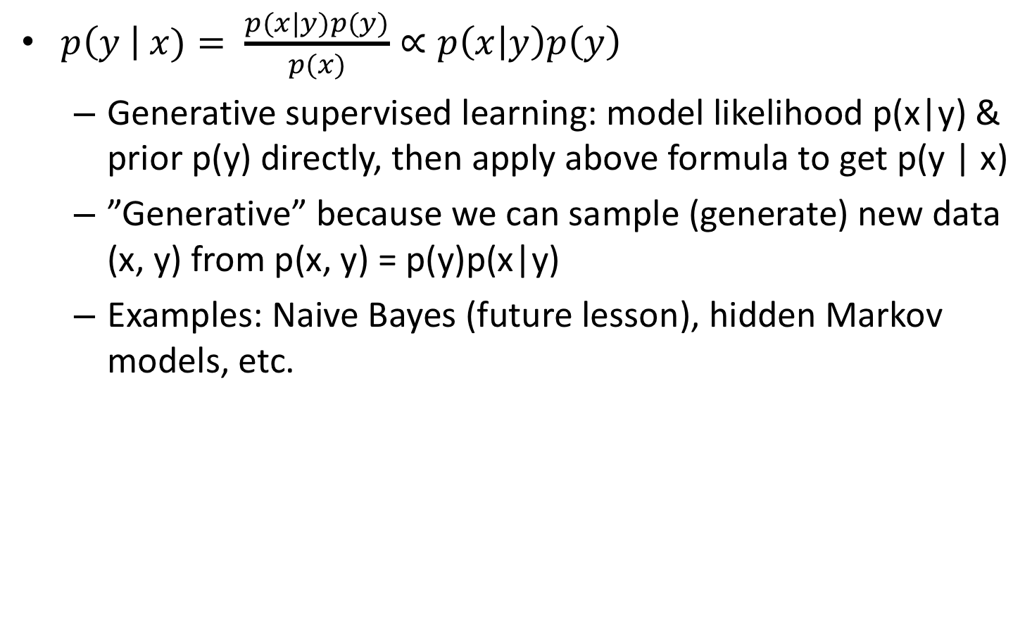
Modeling p(y | x)
$p\left(y \right| x)= \frac{p(x|y)p(y)}{p(x)}∝p\left(x | y\right)p\left(y\right)$
Generative supervised learning: model likelihood p(x|y) & prior p(y) directly, then apply above formula to get p(y | x)
”Generative” because we can sample (generate) new data (x, y) from p(x, y) = p(y)p(x|y)
Examples: Naive Bayes (future lesson), hidden Markov models, etc.
Notes:
Examples of generative supervised learning include naïve bayes and hidden markov models.
Naive Bayes will be covered in a future lesson.

Slide 32
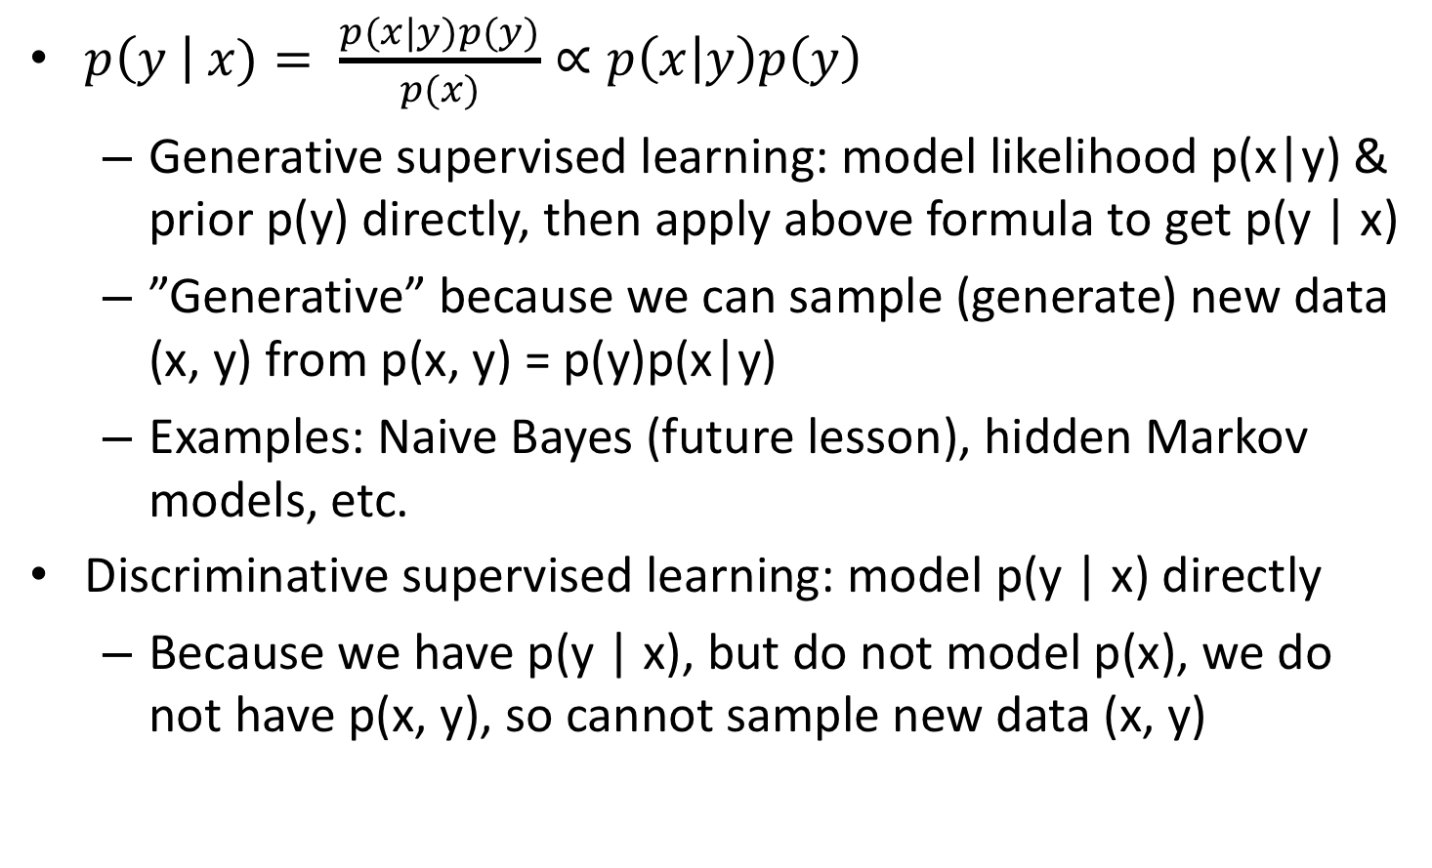
Modeling p(y | x)
$p\left(y \right| x)= \frac{p(x|y)p(y)}{p(x)}∝p\left(x | y\right)p\left(y\right)$
Generative supervised learning: model likelihood p(x|y) & prior p(y) directly, then apply above formula to get p(y | x)
”Generative” because we can sample (generate) new data (x, y) from p(x, y) = p(y)p(x|y)
Examples: Naive Bayes (future lesson), hidden Markov models, etc.
Discriminative supervised learning: model p(y | x) directly
Because we have p(y | x), but do not model p(x), we do not have p(x, y), so cannot sample new data (x, y)
Notes:
For discriminative supervised learning, we model the posterior distribution p(y | x) directly.
Because we only have the posterior p(y | x), but we don’t model p(x), so we do not have the joint distribution p(x, y), so we cannot sample new data x and y.

Slide 33
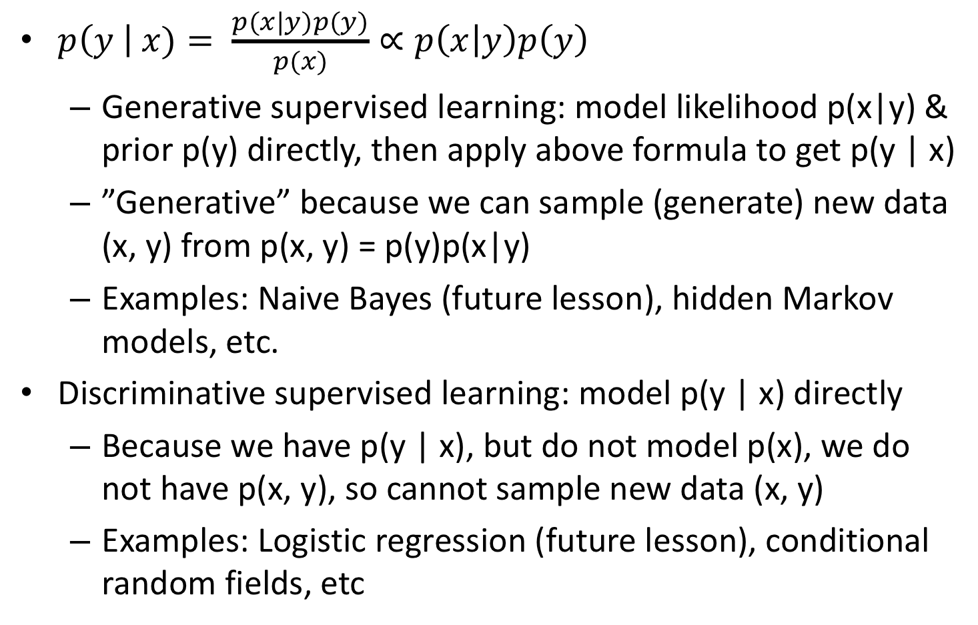
Modeling p(y | x)
$p\left(y \right| x)= \frac{p(x|y)p(y)}{p(x)}∝p\left(x | y\right)p\left(y\right)$
Generative supervised learning: model likelihood p(x|y) & prior p(y) directly, then apply above formula to get p(y | x)
”Generative” because we can sample (generate) new data (x, y) from p(x, y) = p(y)p(x|y)
Examples: Naive Bayes (future lesson), hidden Markov models, etc.
Discriminative supervised learning: model p(y | x) directly
Because we have p(y | x), but do not model p(x), we do not have p(x, y), so cannot sample new data (x, y)
Examples: Logistic regression (future lesson), conditional random fields, etc
Notes:
Examples of discriminative supervised learning include logistic regression, conditional random fields and so on.
So what are the advantages and disadvantages?

Slide 34
Pros and Cons
Suppose our only goal is to predict y from x,
Discriminative approach models p(y | x) directly => focusing all modeling resources on goal directly => generally better accuracy than generative approach
Notes:
Suppose our only goal is to accurately predict y from x.
Then because the discriminative approach models the posterior p(y | x) directly, it is basically focusing all modeling efforts on the goal directly, hence this will generally result in better accuracy than the generative approach.

Slide 35
Pros and Cons
Suppose our only goal is to predict y from x,
Discriminative approach models p(y | x) directly => focusing all modeling resources on goal directly => generally better accuracy than generative approach
Generative model generally more interpretable than discriminative model
Example: Given two features x₁ = y + ℇ and x₂ = -ℇ
Notes:
BUT generative model is usually more interpretable.
Let’s consider this example. Supposed we have two features x1 is equal to y + epsilon and x2 is equal to –epsilon.
You can think of epsilon as noise.

Slide 36
Pros and Cons
Suppose our only goal is to predict y from x,
Discriminative approach models p(y | x) directly => focusing all modeling resources on goal directly => generally better accuracy than generative approach
Generative model generally more interpretable than discriminative model
Example: Given two features x₁ = y + ℇ and x₂ = -ℇ
Perfect (supervised) classification accuracy if we predict y = x₁ + x₂
Notes:
Then we can achieve perfect prediction accuracy if we predict y to be x1 + x2.

Slide 37
Pros and Cons
Suppose our only goal is to predict y from x,
Discriminative approach models p(y | x) directly => focusing all modeling resources on goal directly => generally better accuracy than generative approach
Generative model generally more interpretable than discriminative model
Example: Given two features x₁ = y + ℇ and x₂ = -ℇ
Perfect (supervised) classification accuracy if we predict y = x₁ + x₂
Hard to interpret classifier “1x₁ + 1x₂” because both features are weighted equally (x₁ and x₂ have coefficients of 1), but x₂ serves to cancel noise and has basically no relationship with y.
Notes:
Even though our accuracy is 100%, but it’s hard to interpret the classifier x1+x2 because both features x1 and x2 are weighted equally.
Both x1 and x2 have coefficients of 1. So if we just look at the classifier, we might think both x1 and x2 are equally related to y, but x2 only serves to cancel out noise.

Slide 38
Pros and Cons
Suppose our only goal is to predict y from x,
Discriminative approach models p(y | x) directly => focusing all modeling resources on goal directly => generally better accuracy than generative approach
Generative model generally more interpretable than discriminative model
Example: Given two features x₁ = y + ℇ and x₂ = -ℇ
Perfect (supervised) classification accuracy if we predict y = x₁ + x₂
Hard to interpret classifier “1x₁ + 1x₂” because both features are weighted equally (x₁ and x₂ have coefficients of 1), but x₂ serves to cancel noise and has basically no relationship with y.
Generative models allow us to sample data from p(x, y). If the data looks realistic, then prediction accuracy can be high
Notes:
Finally, generative models allow us to sample data from the joint distribution p(x, y).
If the data looks realistic, then the prediction accuracy can be quite high.

Slide 39
Generative/Discriminative Models Need Not Be Probabilistic
More general definition: Discriminative models are models focused on prediction (e.g., support vector machines)
Notes:
Even though I have motivated generative and discriminative models from the probabilistic perspective, they do not need to be probabilistic.
More generally speaking, Discriminative models are models focused on prediction. For example, support vector machines is a discriminative model, but it’s not probabilistic.

Slide 40
Generative/Discriminative Models Need Not Be Probabilistic
More general definition: Discriminative models are models focused on prediction (e.g., support vector machines)
More general definitions: Generative models are models that can (in principle) be used to “generate” observed data
Notes:
We can also broaden the definition of generative models to be models that can (in principle) be used to “generate” observed data
Does this sound very abstract?

Slide 41

Generative/Discriminative Models Need Not Be Probabilistic
More general definition: Discriminative models are models focused on prediction (e.g., support vector machines)
More general definitions: Generative models are models that can (in principle) be used to “generate” observed data
Newton’s 3 laws of motion is a generative model because the laws allow one to generate trajectories of balls given external forces + initial states
Notes:
A famous generative model is Newton’s 3 laws of motion.
Newton’s 3 laws is a generative model because given knowledge of the external forces and initial states, Newton’s 3 laws allow us to generate trajectories of the balls.

Slide 42
Concept of Generative Models Not Limited To Supervised Learning
Although I introduce generative models in context of supervised learning, generative models can be used in unsupervised learning, where we only have features x
Examples: Gaussian mixture models, latent dirichlet allocation, restricted boltzmann machine, etc
Notes:
Although I introduce generative models in context of supervised learning, generative models can be used in unsupervised learning, where we only have features x
Examples include Gaussian mixture models, latent dirichlet allocation, restricted boltzmann machine,

Slide 43
Concept of Generative Models Not Limited To Supervised Learning
Although I introduce generative models in context of supervised learning, generative models can be used in unsupervised learning, where we only have features x
Examples: Gaussian mixture models, latent dirichlet allocation, restricted boltzmann machine, etc
By definition, discriminative models are focused on prediction => the term “discriminative model” only makes sense in the context of supervised learning
Notes:
BUT for discriminative models, by definition, they are focused on prediction.
Therefore, the term “discriminative model” only makes sense in the context of supervised learning

Slide 44
Concept of Generative Models Not Limited To Supervised Learning
Although I introduce generative models in context of supervised learning, generative models can be used in unsupervised learning, where we only have features x
Examples: Gaussian mixture models, latent dirichlet allocation, restricted boltzmann machine, etc
By definition, discriminative models are focused on prediction => the term “discriminative model” only makes sense in the context of supervised learning
Neural networks can be generative or discriminative
Notes:
Finally, it is worth mentioning that neural networks can be generative or discriminative.

Slide 45
Questions?
Notes:
Any questions before I continue?

Slide 46
Probabilistic Estimation of Model Parameters
Notes:
Once we have a picked a particular generative or discriminative model, how can we estimate the model parameters?

Slide 47
Probabilistic Estimation of Model Parameters
Previous example:
p(y = chair | x = photo) = 0.6
p(y = human | x = photo) = 0.3
p(y = cat | x = photo) = 0.1
Notes:
Let’s consider our previous example.
Probability of chair given the photograph is 0.6. Probability of human given the photograph is 0.3. Probability of cat given the photograph is 0.1.

Slide 48
Probabilistic Estimation of Model Parameters
Previous example:
p(y = chair | x = photo) = 0.6
p(y = human | x = photo) = 0.3
p(y = cat | x = photo) = 0.1
How can 0.6, 0.3 and 0.1 appear on right side, but not left side of “=“ sign?
Notes:
Why do 0.6, 0.3 and 0.1 appear on the right hand side of the equal sign, but not the left hand side?

Slide 49
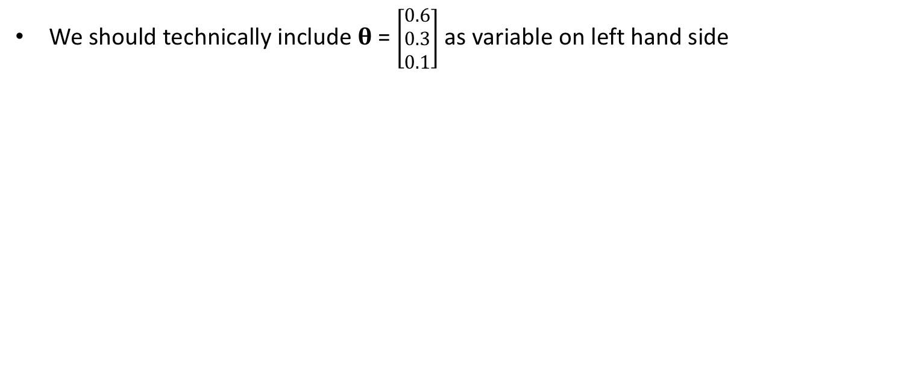
Probabilistic Estimation of Model Parameters
Previous example:
p(y = chair | x = photo) = 0.6
p(y = human | x = photo) = 0.3
p(y = cat | x = photo) = 0.1
How can 0.6, 0.3 and 0.1 appear on right side, but not left side of “=“ sign?
We should technically include 𝛉 = $\left[\begin{matrix}0.6 \\ 0.3 \\ 0.1\end{matrix}\right]$ as variable on left hand side
Notes:
The more correct thing to do is to define a variable theta, which is a vector, whose elements are 0.6, 0.3 and 0.1.
And theta should appear on the left hand side.

Slide 50
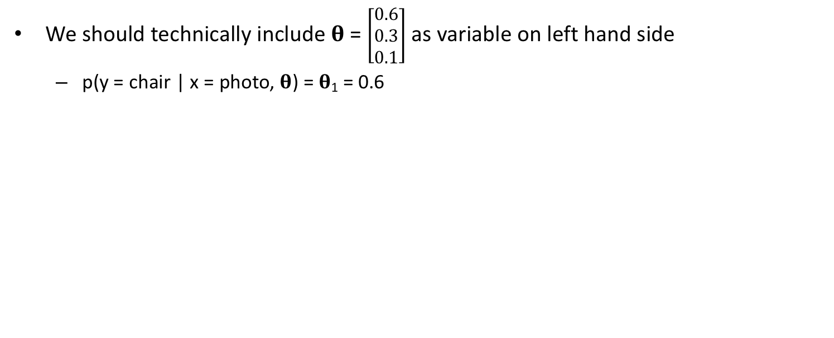
Probabilistic Estimation of Model Parameters
Previous example:
p(y = chair | x = photo) = 0.6
p(y = human | x = photo) = 0.3
p(y = cat | x = photo) = 0.1
How can 0.6, 0.3 and 0.1 appear on right side, but not left side of “=“ sign?
We should technically include 𝛉 = $\left[\begin{matrix}0.6 \\ 0.3 \\ 0.1\end{matrix}\right]$ as variable on left hand side
p(y = chair | x = photo, 𝛉) = 𝛉₁ = 0.6
Notes:
More specifically, posterior probability of y = chair GIVEN x = photo and THETA is equal to theta1, which is the first element of the theta vector, which is equal to 0.6

Slide 51
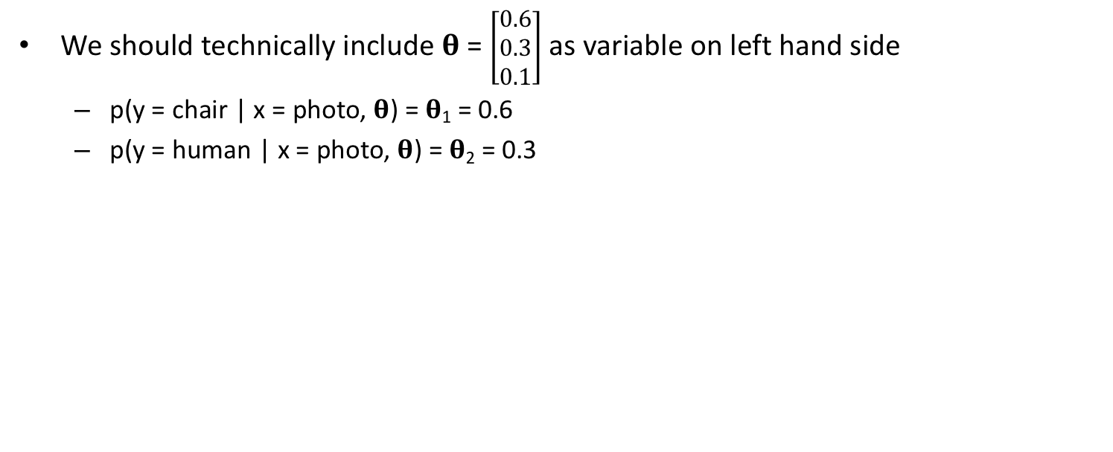
Probabilistic Estimation of Model Parameters
Previous example:
p(y = chair | x = photo) = 0.6
p(y = human | x = photo) = 0.3
p(y = cat | x = photo) = 0.1
How can 0.6, 0.3 and 0.1 appear on right side, but not left side of “=“ sign?
We should technically include 𝛉 = $\left[\begin{matrix}0.6 \\ 0.3 \\ 0.1\end{matrix}\right]$ as variable on left hand side
p(y = chair | x = photo, 𝛉) = 𝛉₁ = 0.6
p(y = human | x = photo, 𝛉) = 𝛉₂ = 0.3
Notes:
posterior probability of y = human GIVEN x = photo and THETA is equal to theta2, which is the second element of the theta vector, which is equal to 0.3

Slide 52
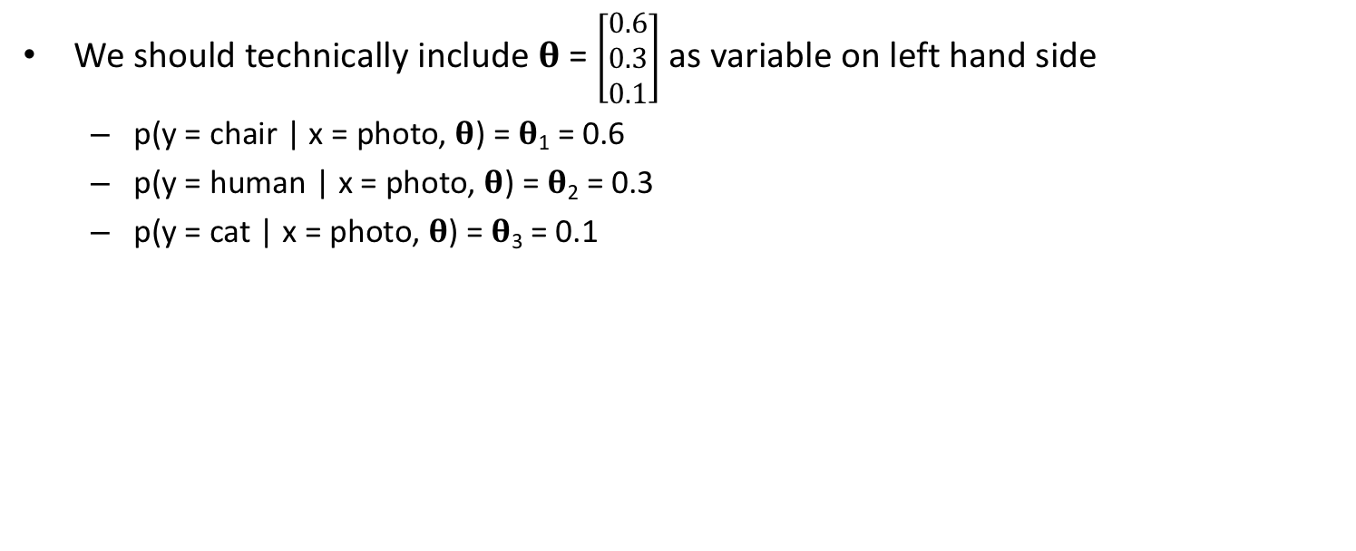
Probabilistic Estimation of Model Parameters
Previous example:
p(y = chair | x = photo) = 0.6
p(y = human | x = photo) = 0.3
p(y = cat | x = photo) = 0.1
How can 0.6, 0.3 and 0.1 appear on right side, but not left side of “=“ sign?
We should technically include 𝛉 = $\left[\begin{matrix}0.6 \\ 0.3 \\ 0.1\end{matrix}\right]$ as variable on left hand side
p(y = chair | x = photo, 𝛉) = 𝛉₁ = 0.6
p(y = human | x = photo, 𝛉) = 𝛉₂ = 0.3
p(y = cat | x = photo, 𝛉) = 𝛉₃ = 0.1
Notes:
Posterior probability of y = cat GIVEN x = photo and THETA is equal to theta3, which is the third element of the theta vector, which is equal to 0.1

Slide 53
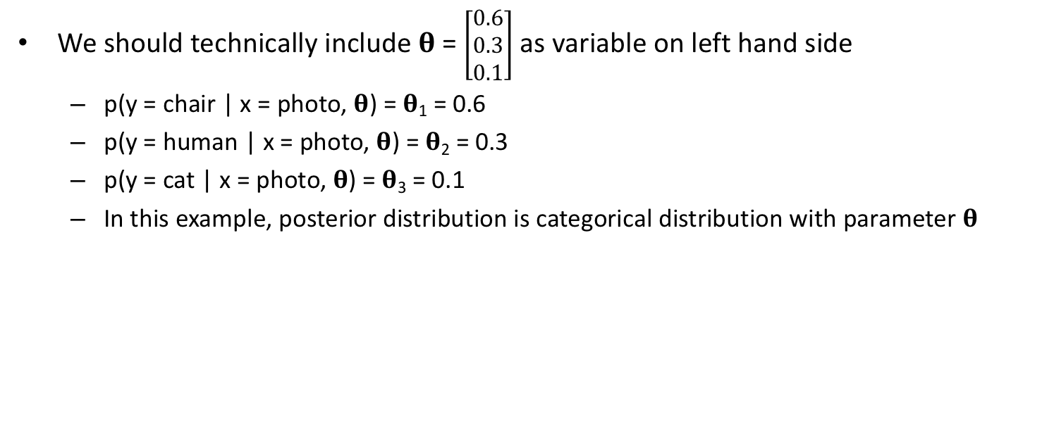
Probabilistic Estimation of Model Parameters
Previous example:
p(y = chair | x = photo) = 0.6
p(y = human | x = photo) = 0.3
p(y = cat | x = photo) = 0.1
How can 0.6, 0.3 and 0.1 appear on right side, but not left side of “=“ sign?
We should technically include 𝛉 = $\left[\begin{matrix}0.6 \\ 0.3 \\ 0.1\end{matrix}\right]$ as variable on left hand side
p(y = chair | x = photo, 𝛉) = 𝛉₁ = 0.6
p(y = human | x = photo, 𝛉) = 𝛉₂ = 0.3
p(y = cat | x = photo, 𝛉) = 𝛉₃ = 0.1
In this example, posterior distribution is categorical distribution with parameter 𝛉
Notes:
In this example, posterior distribution is a categorical distribution with parameter theta.
And in fact, for classification, by definition, we are predicting discrete labels, not continuous variables, therefore the posterior is always a categorical distribution.

Slide 54
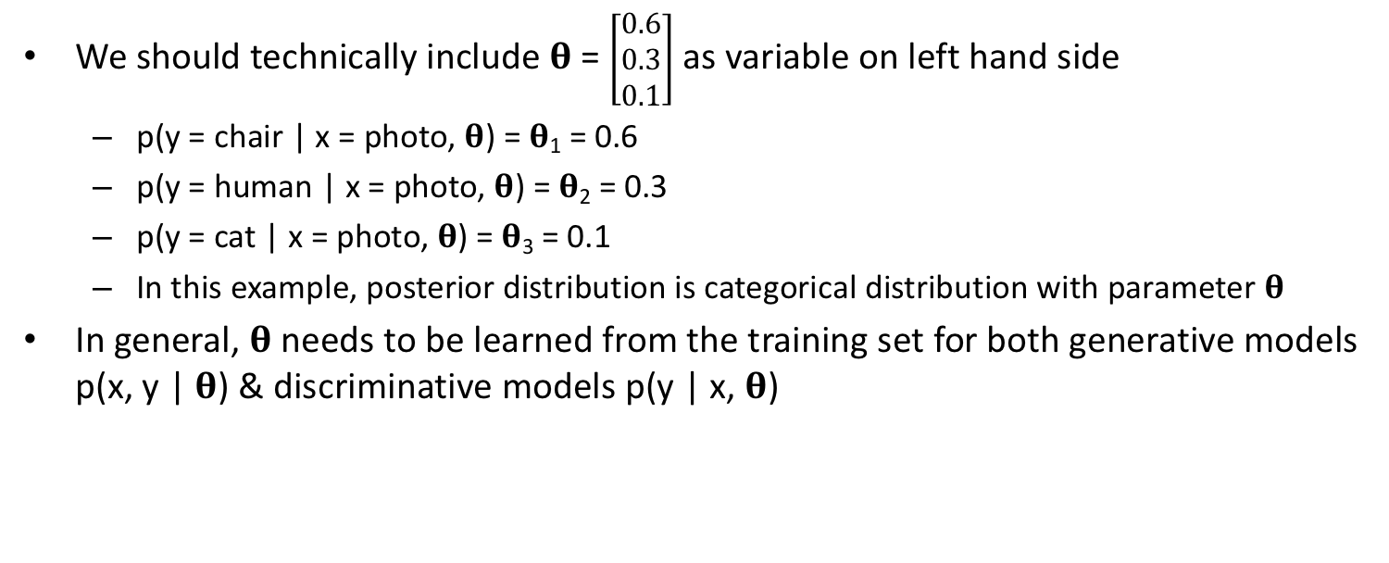
Probabilistic Estimation of Model Parameters
Previous example:
p(y = chair | x = photo) = 0.6
p(y = human | x = photo) = 0.3
p(y = cat | x = photo) = 0.1
How can 0.6, 0.3 and 0.1 appear on right side, but not left side of “=“ sign?
We should technically include 𝛉 = $\left[\begin{matrix}0.6 \\ 0.3 \\ 0.1\end{matrix}\right]$ as variable on left hand side
p(y = chair | x = photo, 𝛉) = 𝛉₁ = 0.6
p(y = human | x = photo, 𝛉) = 𝛉₂ = 0.3
p(y = cat | x = photo, 𝛉) = 𝛉₃ = 0.1
In this example, posterior distribution is categorical distribution with parameter 𝛉
In general, 𝛉 needs to be learned from the training set for both generative models p(x, y | 𝛉) & discriminative models p(y | x, 𝛉)
Notes:
In general, theta is NOT given to us.
Theta needs to be learned from the training set for both generative models and discriminative models.

Slide 55
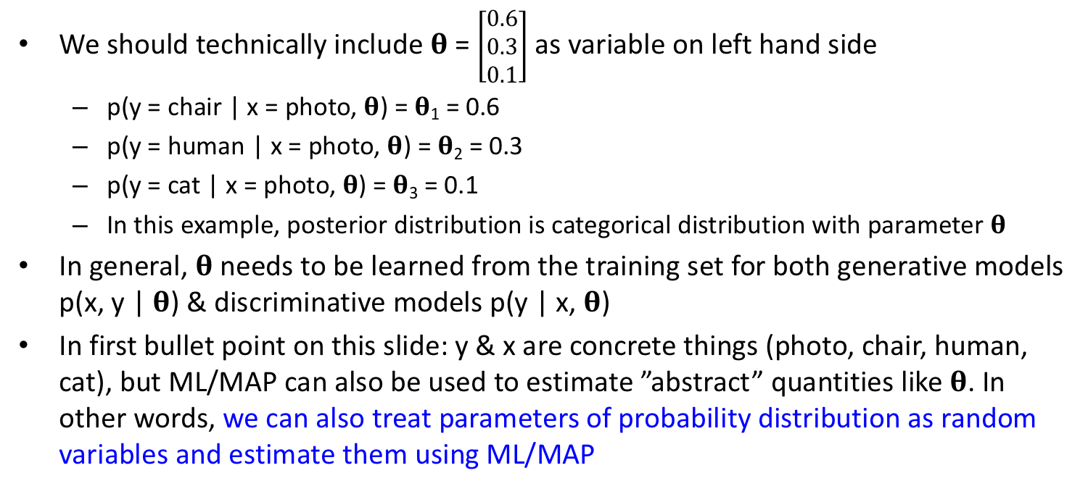
Probabilistic Estimation of Model Parameters
Previous example:
p(y = chair | x = photo) = 0.6
p(y = human | x = photo) = 0.3
p(y = cat | x = photo) = 0.1
How can 0.6, 0.3 and 0.1 appear on right side, but not left side of “=“ sign?
We should technically include 𝛉 = $\left[\begin{matrix}0.6 \\ 0.3 \\ 0.1\end{matrix}\right]$ as variable on left hand side
p(y = chair | x = photo, 𝛉) = 𝛉₁ = 0.6
p(y = human | x = photo, 𝛉) = 𝛉₂ = 0.3
p(y = cat | x = photo, 𝛉) = 𝛉₃ = 0.1
In this example, posterior distribution is categorical distribution with parameter 𝛉
In general, 𝛉 needs to be learned from the training set for both generative models p(x, y | 𝛉) & discriminative models p(y | x, 𝛉)
In first bullet point on this slide: y & x are concrete things (photo, chair, human, cat), but ML/MAP can also be used to estimate ”abstract” quantities like 𝛉. In other words, we can also treat parameters of probability distribution as random variables and estimate them using ML/MAP
Notes:
In the first bullet point on this slide: y and x are concrete things: photo, chair, human, cat,
But maximum likelihood and MAP estimation can also be used to estimate ”abstract” quantities like 𝛉.
In other words, we can also treat parameters of probability distribution as random variables and estimate them

Slide 56
Parameters of Probability Distribution can themselves be treated as random variables
Given training set D = {x_{i}, y_{i}}_{i=1:N}, where x = feature, y = target label
Notes:
Let’s elaborate a bit more.
Suppose we are given training set D consisting of N pairs of x and y, where xi is the feature of the i-th data point and yi is the label of the i-th data point.

Slide 57
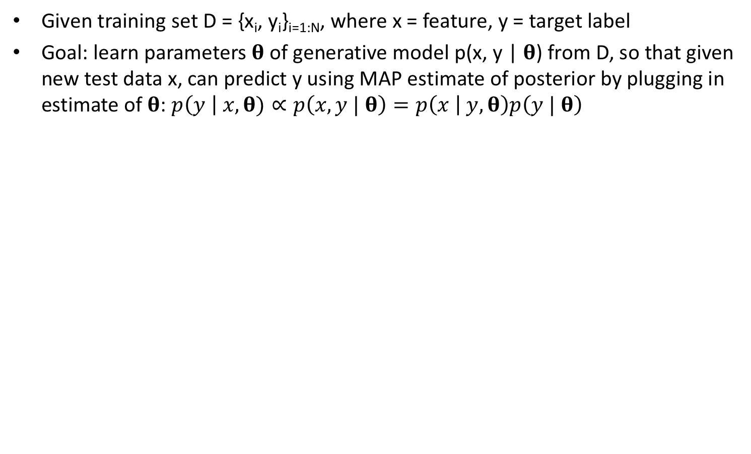
Parameters of Probability Distribution can themselves be treated as random variables
Given training set D = {x_{i}, y_{i}}_{i=1:N}, where x = feature, y = target label
Goal: learn parameters 𝛉 of generative model p(x, y | 𝛉) from D, so that given new test data x, can predict y using MAP estimate of posterior by plugging in estimate of 𝛉: $p\left(y \right| x,\text{θ})∝p\left(x, y | \text{θ}\right)=p\left(x | y,\text{θ}\right)p\left(y | \text{θ}\right)$
Notes:
Our goal is to learn a generative model p(x, y | 𝛉) from D,
So that given new test data x, we can compute the posterior probability $p\left(y \right| x,\text{θ})$ using Bayes’ rule.
And once we have the posterior probability, we can find the best y using MAP estimation.

Slide 58
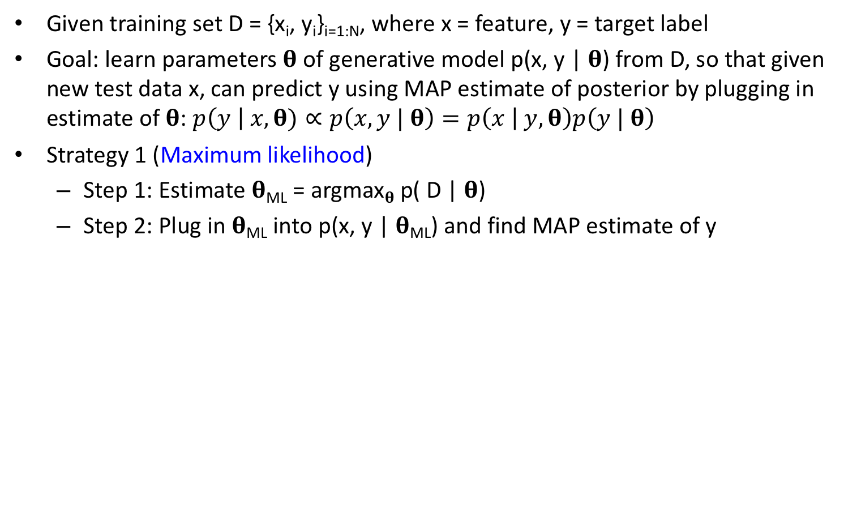
Parameters of Probability Distribution can themselves be treated as random variables
Given training set D = {x_{i}, y_{i}}_{i=1:N}, where x = feature, y = target label
Goal: learn parameters 𝛉 of generative model p(x, y | 𝛉) from D, so that given new test data x, can predict y using MAP estimate of posterior by plugging in estimate of 𝛉: $p\left(y \right| x,\text{θ})∝p\left(x, y | \text{θ}\right)=p\left(x | y,\text{θ}\right)p\left(y | \text{θ}\right)$
Strategy 1 (Maximum likelihood)
Step 1: Estimate 𝛉_{ML} = argmax_{𝛉} p( D | 𝛉)
Step 2: Plug in 𝛉_{ML} into p(x, y | 𝛉_{ML}) and find MAP estimate of y
Notes:
The first strategy is to find the maximum likelihood estimate of theta.
We can then plug in the maximum likelihood estimate of theta into the joint distribution p of x and y given theta and then find the MAP estimate of y.

Slide 59
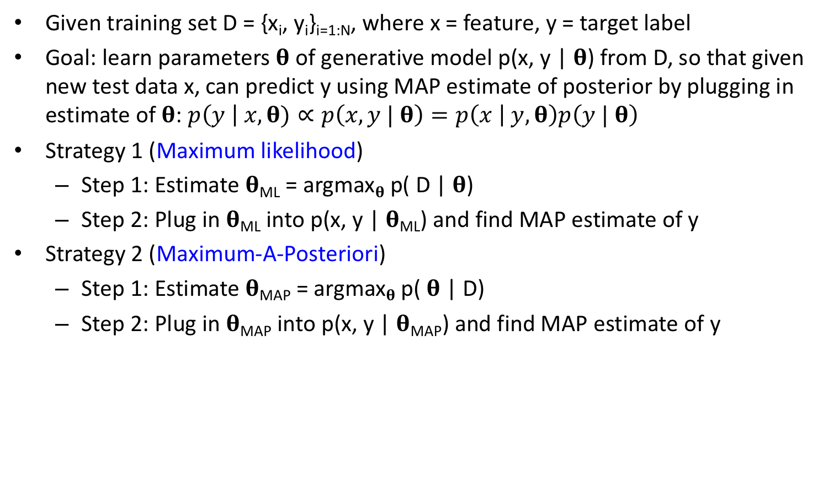
Parameters of Probability Distribution can themselves be treated as random variables
Given training set D = {x_{i}, y_{i}}_{i=1:N}, where x = feature, y = target label
Goal: learn parameters 𝛉 of generative model p(x, y | 𝛉) from D, so that given new test data x, can predict y using MAP estimate of posterior by plugging in estimate of 𝛉: $p\left(y \right| x,\text{θ})∝p\left(x, y | \text{θ}\right)=p\left(x | y,\text{θ}\right)p\left(y | \text{θ}\right)$
Strategy 1 (Maximum likelihood)
Step 1: Estimate 𝛉_{ML} = argmax_{𝛉} p( D | 𝛉)
Step 2: Plug in 𝛉_{ML} into p(x, y | 𝛉_{ML}) and find MAP estimate of y
Strategy 2 (Maximum-A-Posteriori)
Step 1: Estimate 𝛉_{MAP} = argmax_{𝛉} p( 𝛉 | D)
Step 2: Plug in 𝛉_{MAP} into p(x, y | 𝛉_{MAP}) and find MAP estimate of y
Notes:
Strategy 2 is very similar to strategy 1, except that instead of using maximum likelihood to estimate theta, we estimate theta using MAP estimation.
And then like before, we can then plug in the MAP estimate of theta into the joint distribution p of x and y given theta and then find the MAP estimate of y.

Slide 60
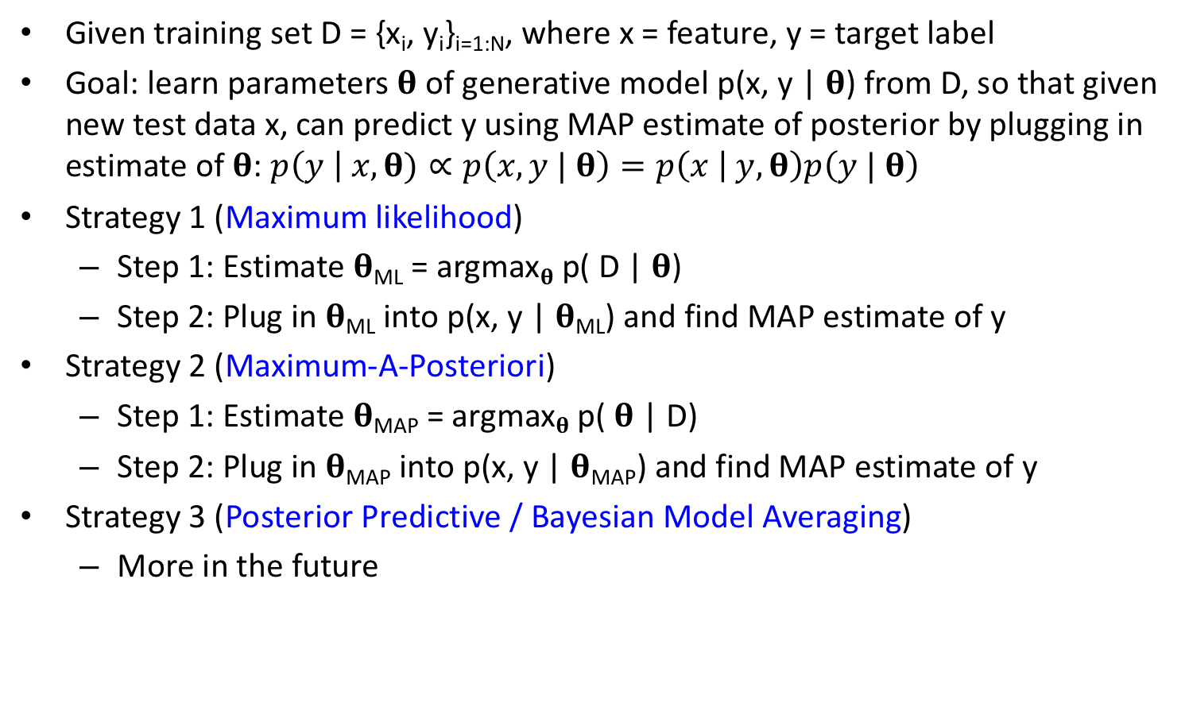
Parameters of Probability Distribution can themselves be treated as random variables
Given training set D = {x_{i}, y_{i}}_{i=1:N}, where x = feature, y = target label
Goal: learn parameters 𝛉 of generative model p(x, y | 𝛉) from D, so that given new test data x, can predict y using MAP estimate of posterior by plugging in estimate of 𝛉: $p\left(y \right| x,\text{θ})∝p\left(x, y | \text{θ}\right)=p\left(x | y,\text{θ}\right)p\left(y | \text{θ}\right)$
Strategy 1 (Maximum likelihood)
Step 1: Estimate 𝛉_{ML} = argmax_{𝛉} p( D | 𝛉)
Step 2: Plug in 𝛉_{ML} into p(x, y | 𝛉_{ML}) and find MAP estimate of y
Strategy 2 (Maximum-A-Posteriori)
Step 1: Estimate 𝛉_{MAP} = argmax_{𝛉} p( 𝛉 | D)
Step 2: Plug in 𝛉_{MAP} into p(x, y | 𝛉_{MAP}) and find MAP estimate of y
Strategy 3 (Posterior Predictive / Bayesian Model Averaging)
More in the future
Notes:
The third strategy is Posterior Predictive or Bayesian Model Averaging. The set up is a bit different, so we will discuss another time.

Slide 61
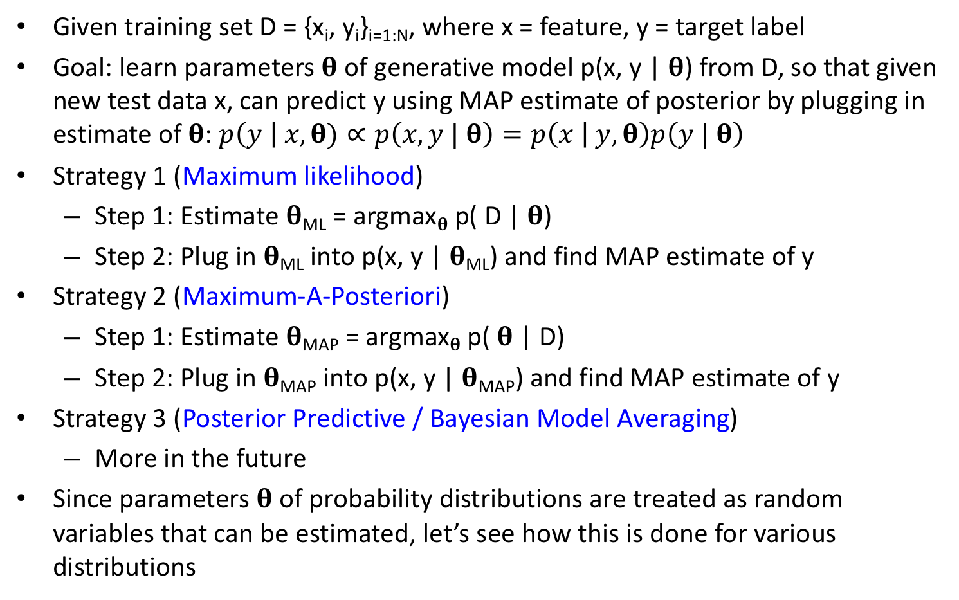
Parameters of Probability Distribution can themselves be treated as random variables
Given training set D = {x_{i}, y_{i}}_{i=1:N}, where x = feature, y = target label
Goal: learn parameters 𝛉 of generative model p(x, y | 𝛉) from D, so that given new test data x, can predict y using MAP estimate of posterior by plugging in estimate of 𝛉: $p\left(y \right| x,\text{θ})∝p\left(x, y | \text{θ}\right)=p\left(x | y,\text{θ}\right)p\left(y | \text{θ}\right)$
Strategy 1 (Maximum likelihood)
Step 1: Estimate 𝛉_{ML} = argmax_{𝛉} p( D | 𝛉)
Step 2: Plug in 𝛉_{ML} into p(x, y | 𝛉_{ML}) and find MAP estimate of y
Strategy 2 (Maximum-A-Posteriori)
Step 1: Estimate 𝛉_{MAP} = argmax_{𝛉} p( 𝛉 | D)
Step 2: Plug in 𝛉_{MAP} into p(x, y | 𝛉_{MAP}) and find MAP estimate of y
Strategy 3 (Posterior Predictive / Bayesian Model Averaging)
More in the future
Since parameters 𝛉 of probability distributions are treated as random variables that can be estimated, let’s see how this is done for various distributions
Notes:
I hope it is now clear that the parameters of probability distributions can themselves be treated as random variables, which can then be estimated.
Let’s see how this is done for various distributions.

Slide 62
Questions?
Notes:
Any questions before I continue?

Slide 63
Beta-Binomial Generative Model (multiple coin tossing)
Notes:
Any questions before we discuss the beta-binomial generative model?

Slide 64
Binomial Distribution
Notes:
Suppose we toss a coin N times. The resulting data consists of the number of tails N0, and the number of heads N1.
Let theta be the probability of obtain a head in a single coin toss.

Slide 65
Binomial Distribution
Notes:
Then the probability of the data given theta follows the binomial distribution with parameters N and theta.
The formula for the binomial likelihood is N choose N1 TIMES theta to the power of N1 TIMES 1 – theta to the power of N0.
So far so good?
Now theta is the parameter of the binomial distribution.

Slide 66
Let’s Model 𝛉 as a Random Variable
Notes:
Let’s model theta as a random variable. In particular, let’s assume a beta prior probability distribution on theta.
The beta distribution has two parameters a and b. Both a and b are greater than 0. They have a special name, called hyperparameters of the prior probability distribution.
So p of theta GIVEN a and b is equal to the Beta distribution of theta GIVEN a and b.

Slide 67
Let’s Model 𝛉 as a Random Variable
Notes:
This is equal to theta to the power of a – 1 TIMES 1 – theta to the POWER of b – 1.
The term B(a, b) is a normalization constant, which ensures the integral of this probability distribution with respect to theta is equal to 1.

Slide 68
Let’s Model 𝛉 as a Random Variable
Notes:
B of a and b can be written in terms of the Gamma function, which is defined here.

Slide 69
Let’s Model 𝛉 as a Random Variable
Notes:
We see that the binomial and beta distributions look very similar. Theta to the POWER of something TIMES (1 – theta) to the power of something. The difference is that N1 and N0 are integers while a and b can be non-integers.
This is NOT an accident. The importance will be seen soon.

Slide 70
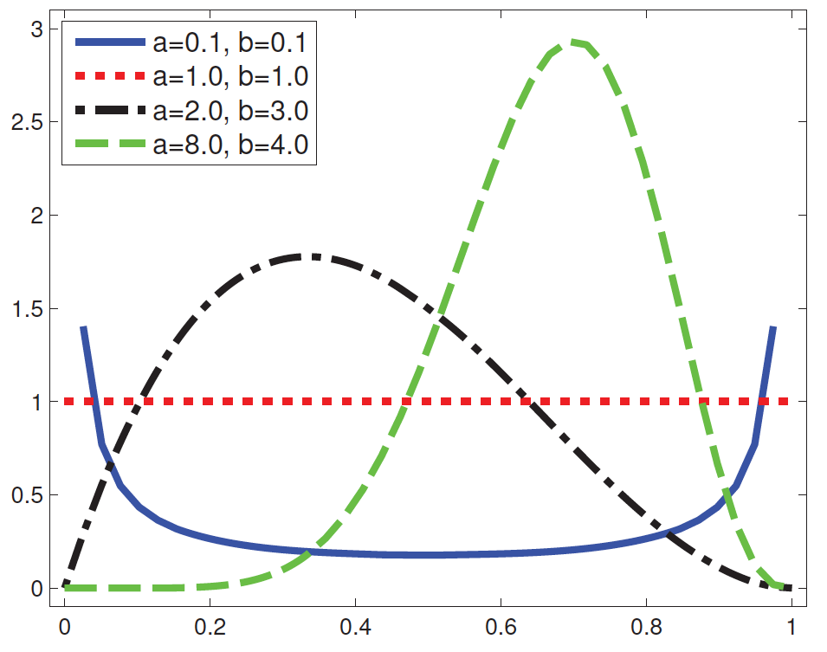
Let’s Model 𝛉 as a Random Variable
Notes:
Here’s a visualization of the beta distribution with different values of a and b.
When a and b are 1, then we get the red line, which is a uniform distribution.
If a and b are less than 1, then we get the blue line, where low and high theta are more likely than intermediate values of theta. So this means that we are likely to get a coin that is either biased towards heads or biased towards tails.
If a and b are greater than 1, we get the green and black lines, where low theta and high theta are less likely than intermediate values.
If a is greater than b, then we get something like the green line where theta is likely to be greater than 0.5, so the coin is more likely to be biased towards generating more heads.
If b is greater than a, then we get something like the black line where theta is likely to be less than 0.5, so the coin is more likely to be biased towards generating more tails.

Slide 71
Beta-Binomial Model
Notes:
The posterior p(theta | D) is equal to p(D | theta) TIMES p(theta) DIVIDED by p(D).

Slide 72
Beta-Binomial Model
Notes:
P(D | theta) is the binomial distribution, which is N choose N1 TIMES theta to the power of N1 TIMES (1 – THETA) to the POWER of N0.
And p(theta) is the beta distribution. 1 DIVIDED by B(a, b) TIMES theta to the power of a -1 TIMES (1 – THETA) to the power of b – 1.

Slide 73
Beta-Binomial Model
Notes:
Let’s collect all the theta terms, we have theta to the POWER of N1 TIMES theta to the power of a – 1, giving us theta to the power of N1 + a – 1.
Collecting all the 1- theta terms, we have 1 - theta to the POWER of N0 TIMES (1 – theta) to the power of b – 1 which gives us (1 – theta) to the power of N0 + b – 1.
The remaining terms are N choose N1, 1 divided by B(a, b) and the evidence p(D).
As we can see, the form of this equation is the same as the beta distribution. Theta to the power of something -1 TIMES (1 – theta) to the power of something – 1. So this is almost like a beta distribution with parameters N1+a and parameters N0+b.
What we lack is the term 1 divided by B(N1+a, N0+b).

Slide 74
Beta-Binomial Model
Notes:
Which we introduce here, B(N1+a, N0+b) divided by B(N1+a, N0+b) is one.

Slide 75
Beta-Binomial Model
Notes:
We can group the theta terms and the denominator into a beta distribution with parameters N1+a and N0+b.
Let’s collect these remaining terms as kappa. Kappa is a function of N0, N1, a and b, but is independent of theta.
And so the posterior consists of kappa TIMES the beta distribution divided by the evidence.

Slide 76
Beta-Binomial Model
Notes:
Kappa is equal to p(D) and so they cancel, resulting in the Beta distribution of theta with parameters N1+a and N0 + b
Why is Kappa equal to p(D)?
To see this, let’s integrate the both sides of the equal sign with theta. If we integrate the left hand side p(theta | D) with respect to theta, we get 1.
If we integrate the right hand side with respect to theta, we get kappa divided by p(D). Therefore kappa is equal to p(D).

Slide 77
Beta-Binomial Model
Notes:
Therefore the parameters of the posterior are obtained by adding the prior hyperparameters a and b to the observed counts N1 and N0.
Therefore we call a and b pseudocounts.

Slide 78
Beta-Binomial Model
Notes:
Because the posterior is the same form as the prior, so we say that beta is a conjugate prior of the binomial distribution.

Slide 79
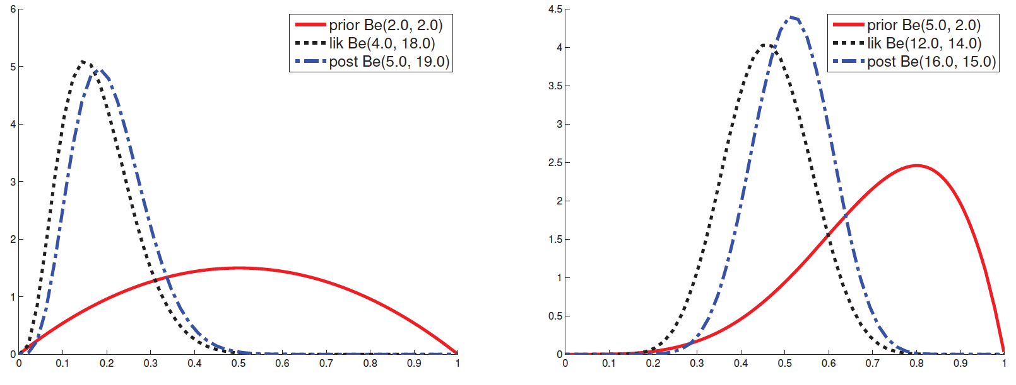
Beta-Binomial Model
Observe posterior tends to be “between” likelihood and prior
Notes:
Here are some plots of beta prior, binomial likelihood and beta posterior.
The red lines are the prior, black lines are the likelihood, blue lines are the posterior.
Observe that the blue line (the posterior) tends to fall between the black and red curves. That’s because the posterior has to trade off between our prior beliefs and the observed data.

Slide 80
MAP, ML Estimates
Notes:
Let us now derive the MAP and ML estimates for the beta-binomial model.
For a beta distribution with parameters c and d, the mode of the distribution is c – 1 DIVIDED by c + d – 2.
Beta is a standard probability distribution, this information can be found on wikipedia. Or we can derive it using standard calculus. This is actually a problem in this week’s assignment.

Slide 81
MAP, ML Estimates
Notes:
We have shown that the posterior distribution P(theta | D) is a beta distribution with parameters N1 + a, and N0 + b

Slide 82
MAP, ML Estimates
Notes:
The MAP estimate of theta is the value of theta that maximizes the posterior p(theta | D). In other words, the MAP estimate is the mode of the posterior distribution.
So we plug in c to be N1 + a and plug in d to be N0 + b, and so the MAP estimate of theta is N1 + a -1 DIVIDED by N + a + b – 2.

Slide 83
MAP, ML Estimates
Notes:
To get the ML estimate, we set the prior to be uniform distribution, which corresponds to a and b to be 1.
And so the ML estimate is N1 divided by N, which is the fraction of heads observed in the coin tosses.
I will now show that the MAP estimate is the tradeoff between the ML estimate and our prior.

Slide 84
MAP Trades Off Prior and Observations
Notes:
Here are the MAP and ML estimates from the previous slide.

Slide 85
MAP Trades Off Prior and Observations
Notes:
Let m0 equal a – 1 divided by a + b – 2. This corresponds to the mode of our prior distribution.
Let alpha0 be equal to a + b – 2. We can also think of alpha0 as pseudocounts.

Slide 86
MAP Trades Off Prior and Observations
Notes:
The MAP estimate is N1 + a – 1 DIVIDED by N + a + b – 2.

Slide 87
MAP Trades Off Prior and Observations
Notes:
Notice that if we multiply m0 and alpha 0, the term a+b-2 is canceled out, so we are left with a – 1. Therefore, we can replace a – 1 with m0 TIMES alpha 0.
And we can replace a + b – 2 with alpha0.
So we end up with N1 + m0 TIMES alpha 0 DIVIDED by N + alpha0.

Slide 88
MAP Trades Off Prior and Observations
Notes:
Let split the numerator into two terms. N1 is equal to N TIMES N1 divided by N. Therefore N1 divided by N + alpha0 is equal to N divided by N + alpha0 TIMES N1 divided by N.
Similarly the second term becomes alpha0 DIVIDED by N + alpha0 TIMES m0

Slide 89
MAP Trades Off Prior and Observations
Notes:
Let’s define lambda to be equal to alpha0 DIVIDED by N + alpha 0. m0.
Then the MAP estimate of theta is (1 – lambda) TIMES ML estimate + lambda TIMES the prior mode m0.

Slide 90
MAP Trades Off Prior and Observations
Notes:
Therefore the MAP estimate of theta is a convex combination of ML estimate and prior mode.
When alpha0 is small, the prior is weak and so lambda is small and so the MAP estimate is close to the ML estimate.

Slide 91
MAP Trades Off Prior and Observations
Notes:
When N goes to infinity, lambda also tends to 0, and so the MAP estimate tends towards the ML estimate.
<QUESTIONS?>

Slide 92
Predicting Future Coin Tosses
Notes:
Now suppose we have observed N coin tosses, so we have training data D, consisting of N0 tails and N1 heads.
Let x tilde be the outcome of the next coin toss. What is the probability that x tilde is equal to 1.

Slide 93
Predicting Future Coin Tosses
Notes:
The first strategy is to simply predict the probability that x tilde is a head to be the maximum likelihood estimate of theta that we discussed in the previous slide.

Slide 94
Predicting Future Coin Tosses
Notes:
The second strategy is to predict the probability that x tilde is a head to be the MAP estimate of theta that we discussed in the previous slide.

Slide 95
Predicting Future Coin Tosses
Notes:
The problem with the maximum likelihood and MAP strategies is that they are not exactly optimal.
In the above problem, the question is ”Suppose we are given D, what is the probability that x tilde is equal to 1”.
So we actually want to evaluate p of x tilde = 1 given D.
But this is not equal to the maximum likelihood estimate or the MAP estimate of theta.
How do we compute this probability?

Slide 96
Posterior Predictive Distribution
Notes:
First, just to let you know that for a beta distribution with parameters c and d, the mean of the distribution is c DIVIDED by c + d
Again, we can find this from wikipedia or compute using simple calculus.

Slide 97
Posterior Predictive Distribution
Notes:
And we have shown that the posterior p(theta | D) is beta distribution with parameters N1+ a and N0 + b.
Let x tilde be the outcome of a single future coin toss after observing the data D.

Slide 98
Posterior Predictive Distribution
Notes:
We want to know the probability of obtaining a head in the future coin toss given that we have already observed a bunch of coin tosses D

Slide 99
Posterior Predictive Distribution
Notes:
Using the law of total probability, this is equal to the integral from 0 to 1 p of x-tilde equal 1 and theta given D, where the integral is with respect to theta.

Slide 100
Posterior Predictive Distribution
Notes:
Applying the rule of conditional probability, we can split this joint probability into p(theta | D) TIMES p of xtilde =1 GIVEN theta and D.

Slide 101
Posterior Predictive Distribution
Notes:
Of course, once we condition on theta, then D and xtilde are conditionally independent, and we can remove D.
Because if we KNOW for sure the probability of getting a head from the coin, then observing more data will not matter.

Slide 102
Posterior Predictive Distribution
Notes:
The probability of obtaining a head is simply theta.

Slide 103
Posterior Predictive Distribution
Notes:
This expression is the mean of the posterior distribution.
The posterior distribution is a beta distribution with parameters N1+a and N0+b.

Slide 104
Posterior Predictive Distribution
Notes:
And so we plug in c to be N1 + a and d to be N0 + b, and so we get N1 + a DIVIDED by N + a + b

Slide 105
Posterior Predictive Distribution
Notes:
Suppose N goes to infinity, the posterior distribution will become a DIRAC delta function at the MAP estimate of theta.

Slide 106
Posterior Predictive Distribution
Notes:
And so then this posterior predictive distribution p of x tilde = 1 given D can be approximated by replacing the posterior distribution p(theta | D) by a dirac delta function centered at the MAP estimate of theta.

Slide 107
Posterior Predictive Distribution
Notes:
Using the sifting property of dirac delta function, we get the MAP estimate of theta.

Slide 108
Posterior Predictive Distribution
Notes:
This is called the plug-in approximation to the posterior predictive density, where we take a point estimate, such as the MAP estimate, and use it to predict the future

Slide 109
Posterior Predictive Distribution
Notes:
This is of course very common, and something we often do in machine learning. We estimate our classifier on a training set, and then we derive a point estimate of the classifier parameters, which we then apply to new test data.
But just because this is very common, does not mean that it is optimal. The plug-in approximation can result in over-fitting, leading to what is known as the black swan paradox.

Slide 110
Black Swan Paradox (overfitting)
Notes:
So in the black swan paradox, instead of using the posterior predictive distribution, we use a plug-in approximation, such as the Maximum likelihood estimate.
So the probability of getting a head after observing data D is approximated to be the ML estimate of theta, which is the number of observed heads divided by number of coin tosses.

Slide 111
Black Swan Paradox (overfitting)
Notes:
For small sample size, the ML estimate can perform poorly.
For example, if there are 3 coin tosses and all are tails, then the ML estimate is 0, and so we will predict that it is impossible to observe heads in future coin tosses, which is overly pessimistic.

Slide 112
Black Swan Paradox (overfitting)
Notes:
Even in the big data era, once we start partitioning data based on different criteria, for example, the number of times a specific person performs a specific activity, sample size can become very small.

Slide 113
Black Swan Paradox (overfitting)
Notes:
This is called the black swan paradox because in ancient times, there are only white swans.
Using ML estimate, this would mean that it is impossible to observe black swans in the future.
But actually, explorers found black swans in Australia in the 17th century.

Slide 114
Black Swan Paradox (overfitting)
Notes:
We can easily resolve the paradox using the posterior predictive distribution. For example, if we set a and b to be 1, then the probability of observing a black swan after centuries of observing only white swans is very small but not zero.
Because N0 = 0, and N1 is a big number. Therefore N1+1 divided by N1 + 2 is a very small, but not exactly zero. So after centuries of observing white swans, the probability of observing black swan is very small, but not zero.
This approach has a fancy name called Laplace Smoothing.

Slide 115
Black Swan Paradox (overfitting)
Notes:
Note that when a and b are equal to 1, then the prior is a uniform distribution and the MAP estimate is the same as the ML estimate, and so using the MAP estimate will not necessarily solve the black swan paradox.
There is also the Laplace sunrise paradox (https://en.wikipedia.org/wiki/Sunrise_problem).

Slide 116
Questions?
Notes:
Any questions before I continue?

Slide 117
Interlude: Baseball Example
How is this useful?
How to set the hyperparameters of beta distribution?
Notes:
At this point, this might feel a little abstract and you might be thinking. How is this useful?
In addition, how do we set the hyperparameters of the beta distribution?

Slide 118
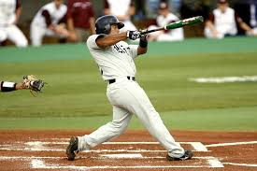
Interlude: Baseball Example
How is this useful?
How to set the hyperparameters of beta distribution?
Empirical Bayes
http://varianceexplained.org/r/empirical_bayes_baseball/
Notes:
There are many ways to set the hyperparameters of the beta distribution. One approach is called empirical Bayes.
And we will use a baseball example to answer both questions.
I have stolen this example from this website. The website actually has more details, so you can take a look at it.

Slide 119
Baseball Recruiter Problem
Suppose I am a baseball recruiter, trying to choose two potential players. Player one has achieved 4 hits in 10 chances. Player 2 has achieved 300 hits in 1000 chances. Who should I recruit?
http://varianceexplained.org/r/empirical_bayes_baseball/
Notes:
So suppose I am a baseball recruiter. I am considering two possible batters to recruit. The first player managed to hit the ball 4 times out of 10 tries. The second player managed to hit the ball 300 times out of 1000 tries. Who should I recruit?

Slide 120
Baseball Recruiter Problem
Suppose I am a baseball recruiter, trying to choose two potential players. Player one has achieved 4 hits in 10 chances. Player 2 has achieved 300 hits in 1000 chances. Who should I recruit?
The typical baseball player hits roughly 25.9% of the time.
Player one has a higher proportion of hits (4/10), but it could be luck since he has only batted 10 times.
Player two has a lower proportion of hits (3/10), but there is a lot of evidence that he is better than average (25.9%)
http://varianceexplained.org/r/empirical_bayes_baseball/
Notes:
It turns out that the typical baseball player hits the ball 25.9% of the time.
The first player has hit the ball 40% of the time. But he could just be lucky because he has only tried 10 times.
On the other hand, the second player has hit the ball 30% of the time. It’s only slightly higher than 27%, but he has tried 1000 times, so intuitively, there is a lot of evidence that the second player is above average, but the first player might just be lucky.
So how do we solve this problem?

Slide 121
Best & Worse Batters in History?
Players with highest average
These aren’t the best batters, they’re just the batters who went up once or twice and got lucky.
Players with lowest average
Name | # Hits | #Total Tries | Average
Jeff Banister | 1 | 1 | 1
Doc Bass | 1 | 1 | 1
Steve Biras | 2 | 2 | 1
C. B. Burns | 1 | 1 | 1
Jackie Gallagher | 1 | 1 | 1
Name | # Hits | #Total Tries | Average
Frank Abercrombie | 0 | 4 | 0
Horace Allen | 0 | 7 | 0
Pete Allen | 0 | 4 | 0
Walter Alston | 0 | 1 | 0
Bill Andrus | 0 | 9 | 0
http://varianceexplained.org/r/empirical_bayes_baseball/
Notes:
Before we continue, let’s look at some real players.
Suppose we sort baseball players by their batting average. Here are the players with the highest betting average. They have 100% hit rate! However, it should be clear that these are NOT the best batters in history. They simply only get to play once or twice and were lucky.
On the other hand, here are the baseball players with the worst batting average. They have 0% hit rate. But again, they have not played so many times, so they might just be unlucky. So we should not conclude them as the worst players in history.
So what can we do?

Slide 122
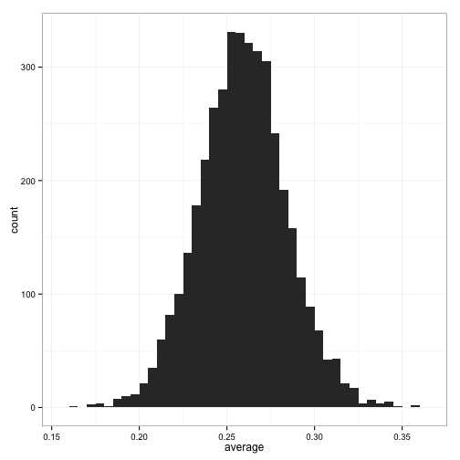
Estimate Prior Distribution
Histogram of Batting
Averages Across Players
Batting Average
http://varianceexplained.org/r/empirical_bayes_baseball/
Notes:
Let’s start by visualizing the batting averages of all baseball players.
You can see that the mean is around 0.27.

Slide 123
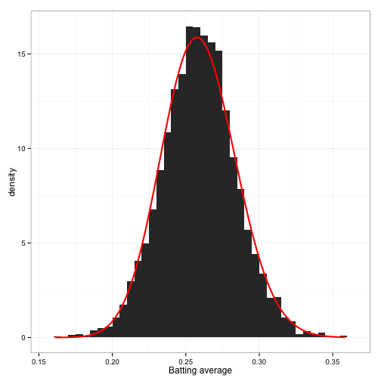
Estimate Prior Distribution
Histogram of Batting
Averages Across Players
Beta distribution (a = 78.7, b = 224.9)
Batting Average
Batting Average
http://varianceexplained.org/r/empirical_bayes_baseball/
Notes:
Let’s fit a beta distribution to the histogram.
Using maximum likelihood, we find that a is equal to 78.7, b is equal to 224.9.
We see from the red curve that the estimate probability distribution fits the empirical data quite well.

Slide 124
Baseball Recruiter Problem
Suppose I am a baseball recruiter, trying to choose two potential players. Player one has achieved 4 hits in 10 chances. Player 2 has achieved 300 hits in 1000 chances. Who should I recruit?
Now we have Beta distribution (a = 78.7, b = 224.9) as a prior
Note that mean = a/(a+b) = 0.259
http://varianceexplained.org/r/empirical_bayes_baseball/
Notes:
We are now ready to revisit the case of the two baseball players.
But now, we are armed with the beta distribution as a prior.
So let’s apply what we have learned in the previous section.

Slide 125
Baseball Recruiter Problem
Suppose I am a baseball recruiter, trying to choose two potential players. Player one has achieved 4 hits in 10 chances. Player 2 has achieved 300 hits in 1000 chances. Who should I recruit?
Now we have Beta distribution (a = 78.7, b = 224.9) as a prior
Note that mean = a/(a+b) = 0.259
Posterior predictive distribution for player one: (4 + a)/(10+a+b) = 0.263
Posterior predictive distribution for player two: (300+a)/(1000+a+b) = 0.291
Therefore, we should recruit player two
http://varianceexplained.org/r/empirical_bayes_baseball/
Notes:
The posterior predictive distribution for player one is 4 + a divided by 10 + a + b, which is 0.26. This means that given that we have observed player one plays 10 times and hit the ball 4 times, the probability of player one hitting the ball the next time he plays is 0.26.
The posterior predictive distribution for player one is 300 + a divided by 1000 + a + b, which is 0.29. This means that given that we have observed player two plays 1000 times and hit the ball 300 times, the probability of player two hitting the ball the next time he plays is 0.29.
Since 0.29 is bigger than 0.26, we should try to recruit player two.

Slide 126
Questions?
Notes:
Any questions before I continue?

Slide 127
Dirichlet-Multinomial Generative Model (Multiple Dice Rolling)
Notes:
The beta-binomial model is concerned with tossing coins. Now let’s consider dice rolling.
Any questions before I continue?

Slide 128
Multinomial Distribution
Notes:
Suppose we toss a K-sided dice N times. The resulting data consists of a collection of Nk’s, where Nk is the number of times the number “k” shows up on the dice.
Let theta k be the probability of the number “k” showing up on the dice. We denote theta to be the collection of theta k.

Slide 129
Multinomial Distribution
Notes:
Then the probability of the data given theta follows the multinomial distribution, which is the generalization of the binomial distribution to k-sided dice.
The formula for the multinomial likelihood is N! divided by N1! TIMES N2! all the way to NK! TIMES theta1 to the POWER of N1 TIMES theta2 to the power of N2, and so on.
Ignoring the constant term with many factorials, we have product from small k equal 1 to big K TIMES theta k to the POWER of Nk.
So far so good?

Slide 130
Let’s Model 𝛉 as a Random Variable
Notes:
Let’s model theta as a random variable. In particular, let’s assume a dirichlet prior probability distribution on theta.
The dirichlet distribution has hyperparameters alpha1, alpha2 to alpha K.
Let’s denote the entire collection of alphak’s as ALPHA.
All the alpha’s have to be greater than 0.

Slide 131
Let’s Model 𝛉 as a Random Variable
Notes:
p(theta | alpha) is equal to the product of theta1 to the power of alpha1 – 1 TIMES theta2 to the power of alpha2 – 1, and so on.
B(alpha) is the multivariate beta function. It is a normalization constant to ensure the integral of this probability distribution with respect to theta1, theta2, theta3 to thetak is equal to 1.
Note that the theta’s have to be at least 0 and the theta’s have to sum to 1.
We see that the multinomial and dirichlet distributions look very similar. Theta1 to the POWER of something TIMES Theta2 to the power of something and so on. The difference is that the Ns are integers while alpha’s can be non-integers.

Slide 132
Let’s Model 𝛉 as a Random Variable
Notes:
We see that the multinomial and dirichlet distributions look very similar. Theta1 to the POWER of something TIMES Theta2 to the power of something and so on. The difference is that the Ns are integers while alpha’s can be non-integers.
Again this is not an accident

Slide 133
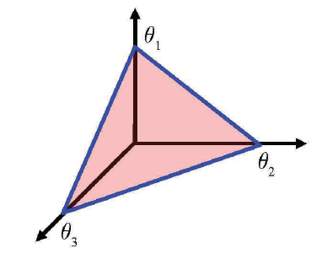
Dirichlet-Multinomial Model
Notes:
The dirichlet distribution is non-zero only for theta’s at least 0 and the theta’s have to sum to 1. The set of theta satisfying this constraint is called the simplex.
For k equal to 3, the set of feasible theta k falls inside a triangle, which we can visualize easily.

Slide 134
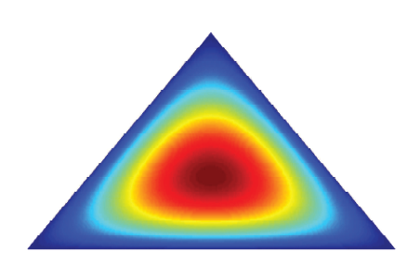
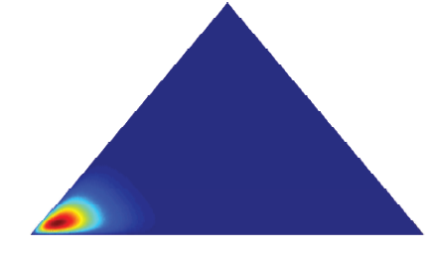
Dirichlet-Multinomial Model
Notes:
When alpha is equal to all 2, we can see that the distribution is symmetric, with the peak theta value is 1/3. So the most likely dice is the fair 3-sided dice.
When alpha is equal to 20, 2, 2, then it is likely that the resulting dice has high probability of rolling a value of 1.

Slide 135
Dirichlet-Multinomial Model
Notes:
Like before we can compute the posterior using Bayes rule.

Slide 136
Dirichlet-Multinomial Model
Notes:
All the theta terms will collect together and the posterior is PROPORTIONAL to the product from k = 1 to CAPITAL K theta k to the power of Nk PLUS alphak MINUS 1
The form of this equation is the same as the dirichlet distribution. Theta1 to the power of something TIMES Theta2 to the power of something and so on.

Slide 137
Dirichlet-Multinomial Model
Notes:
Like in the beta-binomial case, the constant in the numerator will cancel with the evidence p of D, so the posterior distribution is a dirichlet distribution with parameters N1 + alpha 1, N2 + alpha 2, all the way to NK + alphaK.

Slide 138
Dirichlet-Multinomial Model
Notes:
The parameters of the posterior are obtained by adding the hyperparameters alphak’s to the observed counts Nk’s
Therefore alphak’s can be thought of as pseudocounts.

Slide 139
Dirichlet-Multinomial Model
Notes:
Again, the posterior and prior distributions are dirichlet distributions, so the dirichlet distribution is a conjugate prior of the multinomial distribution.
By the way, you can verify for yourself that for capital K = 2, the equations are equivalent to the beta-binomial model.

Slide 140
MAP, ML Estimates
Notes:
Let us now derive the MAP and ML estimates for the dirichlet-multinomial model.
For a dirichlet distribution with parameters gamma1 to gammaK, the mode of the distribution xk is equal to gammak – 1 DIVIDED by sum of gamma k – K.
Remember that x is a vector of length capital K, where the sum of the vector is equal to 1. x small k is the k-th entry of the vector.

Slide 141
MAP, ML Estimates
Notes:
We have shown that the posterior distribution P(theta | D) is a dirichlet distribution with parameters N1 + alpha1, N2+alpha2 all the way to NK + alphaK.

Slide 142
MAP, ML Estimates
Notes:
The MAP estimate of theta is the mode of the posterior dirichlet distribution
So we plug in gamma1 to be N1 + alpha1, gamma2 to be N2 + alpha2 and so on.
Therefore the MAP estimate of theta k is Nk PLUS alphak – 1 DIVIDED by N + sum over all alpha k – capital K

Slide 143
MAP, ML Estimates
Notes:
To get the ML estimate, we set the prior to be uniform distribution, which corresponds to setting all the alphas to be 1
And so the ML estimate of theta k is Nk divided by N, which is the fraction of times the number k show up in the dice rolls.
Again you can go back and verify that if we set capital K to be 2, we get back the MAP and ML estimate of the beta-binomial model.
<So far so good>

Slide 144
Derivation of Dirichlet Mode
Notes:
Before I show you the posterior predictive distribution, I want to show you how to derive the mode of the dirichlet distribution.
It’s standard calculus, so hopefully the math is not new to you.
But this is so frequently used, I want to make sure we are on the same page.

Slide 145
Derivation of Dirichlet Mode
Notes:
So the mode of the distribution corresponds to the value of theta that maximizes the dirichlet pdf, which is given by theta1 to the power of alpha1 – 1 TIMES theta2 to the power of alpha2 – 1 and so on, with a normalization constant 1 over B of alpha.

Slide 146
Derivation of Dirichlet Mode
Notes:
Remember that thetak lie on a simplex, which means that sum of thetak is 1 and all the thetak are at least 0.

Slide 147
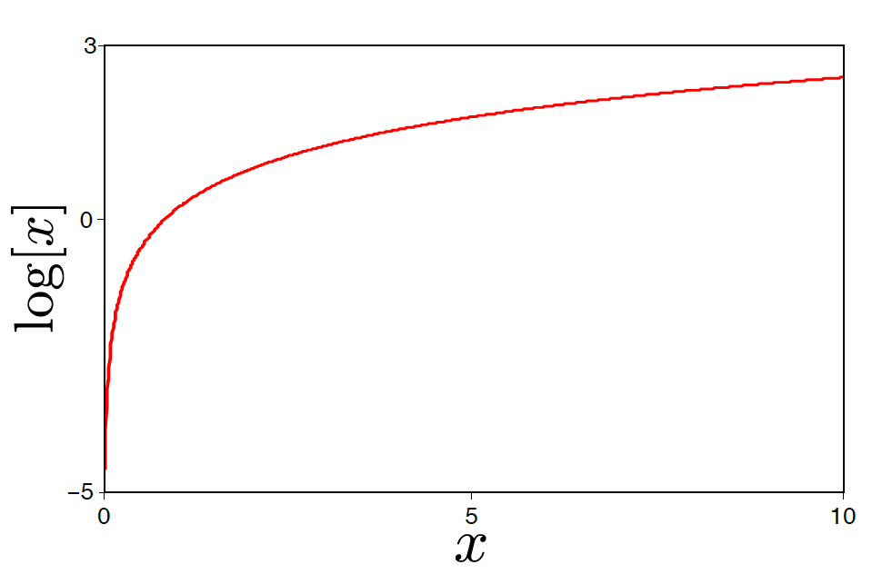
Derivation of Dirichlet Mode
The logarithm is a monotonic transformation.
Hence, the position of the peak stays in the same place But the log probability easier to work with
Notes:
Next we are going to apply log to our equation.
The log is a monotonic function, so the location of the maximum stays the same, but log probability is much easier to work with!

Slide 148
Derivation of Dirichlet Mode
Notes:
So we apply log.
Log of 1 over B(alpha) is not a function of theta so we can throw it away.
Applying log to the product from k = 1 to K, we get a sum from k = 1 to K.
Log of thetak to the power of alphak – 1 is the same as alphak – 1 TIMES log of thetak

Slide 149
Derivation of Dirichlet Mode
Notes:
Now we need to introduce lagrange multiplier lambda to to convert this constrained optimization problem to a non-constrained one.
So the first term of the lagragian is the same as before sum from k = 1 to K (alphak – 1) TIMES log of theta k.
The second term is the lagrange multiplier lambda TIMES (1 – sum of theta k). This second term corresponds to our constraint.

Slide 150
Derivation of Dirichlet Mode
Notes:
We want to differentiate the lagragian with respect to lambda and thetak and set them to 0.

Slide 151
Derivation of Dirichlet Mode
Notes:
Notice that if we differentiate the lagragian with respect to lambda, we get 1 MINUS sum of thetak, which if we set to 0 gives us the original constraint.

Slide 152
Derivation of Dirichlet Mode
Notes:
So let’s differentiate the lagragian with respect to a particular theta i.
So for this sum from k = 1 to K, the only k that survives is when k is equal to i. Therefore we have alpha i – 1 TIMES the derivative of log theta i, which is one over theta i.
For the second term, LAMBDA times 1 is a constant, which drops off. Differentiating LAMBDA TIMES sum over thetak, again all the terms drop off except for k equal to i, so differentiating lambda TIMES theta i gives us lambda.
Which we want to set to 0.

Slide 153
Derivation of Dirichlet Mode
Notes:
Re-arranging the terms, we get thetai is equal to 1 over lambda TIMES alphai – 1
So what is lambda?

Slide 154
Derivation of Dirichlet Mode
Notes:
To find lambda, we exploit the fact that the sum over theta i has to be equal to 1.
Plugging in thetai is equal to 1 over lambda TIMES alphai – 1

Slide 155
Derivation of Dirichlet Mode
Notes:
If we move lambda to the other side of the equation, we get lambda is equal to sum over alpha i – CAPITAL K.

Slide 156
Derivation of Dirichlet Mode
Notes:
Therefore thetak is equal to alphak – 1 DIVIDED by sum over alphak – K.
<So far so good?>

Slide 157
Predicting Future Dice Rolls
Notes:
Now suppose we have observed N dice tosses, so we have training data D, consisting of N1, N2 to Nk. N1 is the number of times the first face of the dice appear. N2 is the number of times the second face of the dice appears and so on.
Let x tilde be the outcome of the next dice roll. What is the probability that x tilde is equal to the i-th face of the dice?

Slide 158
Predicting Future Dice Rolls
Notes:
The first strategy is to simply predict the probability that x tilde is equal to i to be the maximum likelihood estimate of theta that we discussed in the previous slide.
Here theta ML is a vector, so theta i ML is the i-th element of theta ML.

Slide 159
Predicting Future Dice Rolls
Notes:
The second strategy is to predict the probability that x tilde is the i-th face of the dice to be the MAP estimate of theta that we discussed in the previous slide.

Slide 160
Predicting Future Dice Rolls
Notes:
The problem with the maximum likelihood and MAP strategies is that they are not exactly optimal.
In the above problem, the question is ”Suppose we are given D, what is the probability that x tilde is equal to the i-th face of the dice”.
So we actually want to evaluate p of x tilde = i given D.
But this is not equal to the maximum likelihood estimate or the MAP estimate of theta.
How do we evaluate this posterior predictive distribution?

Slide 161
Posterior Predictive Distribution
Notes:
Note that for the dirichlet distribution with parameters gamma1 to gammak, the mean of xi is equal to gamma i divided by SUM of all the gammas
Again, remember that x is a vector of length capital K, where the sum of the vector is equal to 1. x small i is the i-th entry of the vector.

Slide 162
Posterior Predictive Distribution
Notes:
And we have shown that the posterior p(theta | D) is dirichlet with parameters N1+ alpha1, N2+alpha2, and so on.
Let x tilde be the outcome of a single future dice roll after observing the N dice rolls D.

Slide 163
Posterior Predictive Distribution
Notes:
Then the probability the future dice roll showing a value of i given the previous history of dice rolls D
Is equal to the integral p of x tilde equal to I and theta GIVEN D. The integral is multi-dimensional over the simplex theta.
Again, this equality comes from the law of total probability.

Slide 164
Posterior Predictive Distribution
Notes:
Applying the rule of conditional probability, we can split this joint probability into p(theta | D) TIMES p of xtilde = i GIVEN theta and D.

Slide 165
Posterior Predictive Distribution
Conditional Independence
Notes:
Like before, once we condition on theta, then D and xtilde are conditionally independent, and so we can drop D.
And again the reason is that if we know the REAL GROUNDTRUTH biasness of the dice, then seeing more data doesn’t change anything.

Slide 166
Posterior Predictive Distribution
Conditional Independence
Notes:
The probability of observing xtilde to be i GIVEN theta is simply thetai.

Slide 167
Posterior Predictive Distribution
Conditional Independence
Notes:
This is the mean of the posterior distribution p of theta given D
Now, the posterior distribution is dirichlet with parameters N1+alpha1, N2 + alpha 2 and so on.
And so we plug in gamma1 to be N1 + alpha1, gamma2 to be N2+alpha2 and so on.

Slide 168
Posterior Predictive Distribution
Conditional Independence
Notes:
And so the probability of rolling x tilde to be i after observing the data D is equal to Ni + alphai DIVIDED by N + sum of all the alphas

Slide 169
Posterior Predictive Distribution
Conditional Independence
Notes:
The posterior predictive distribution is even more important in multinomial than binomial data because the data become more sparse as we partition it into more categories.

Slide 170
Bag of words example
Notes:
Let’s consider the toy example of applying the dirichlet-multinomial distribution to predict the next word in a text sequence.
Suppose we see the following text: Mary had a little lamb, little lamb, little lamb. Mary had a little lamb, its fleece as white as snow.

Slide 171
Bag of words example
Notes:
Let’s consider the following dictionary of words: mary, lamb, little, big, fleece, white, black, snow, rain and unk, which stands for unknown words, such as “had” and “its”
Let’s number the words from 1 to 10.

Slide 172
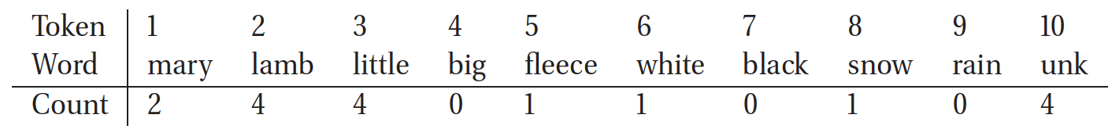
Bag of words example
3
Notes:
We can then convert the text sequence into a histogram of word count.
We do this by ignoring punctuations, like the commas, as well as stop words, which are usually not informative of the content of the document, such as “a”, “as”, “the”, and so on.
So the word mary appears twice in the text, so we have a count of 2. The word lamb appears 4 times in the text sequence so we have a count of 4. There are 3 unknown words, “had” appear twice and “its” appear once.
So what we have done here is to convert a text sequence into a bag of words. Essentially we have ignored the word ordering. This seems like we have lost a lot of information, but surprisingly, the bag of words approach can give pretty good results in natural language processing and information retrieval applications.

Slide 173
Bag of words example
3
Notes:
So here, we are going to treat each word as being generated by a 10-sided dice, where the 10 sides correspond to our 10 dictionary words.
Given the observation of the text sequence, and if we set alpha i to be 1, then the posterior predictive distribution of the next word is Ni + alphai divided by N + sum of all alphas, so we have Ni + 1 divided by 16 (since 2+4+4+1+1+1+3 is equal to 16) and the sum of alpha k is equal to 10.

Slide 174
Bag of words example
3
Notes:
And so we get the following posterior predictive distribution.
According to our simplistic model, the next word likely to appear in the text sequence is “little” and “lamb” with probability equal to 5 over 26.

Slide 175
Bag of words example
3
Notes:
The words big, black and rain have non-zero probability even though they were never observed in the text sequence.
This is the value of the posterior predictive distribution, rather than just using the plug-in MAP or ML estimate.

Slide 176
Questions?
Notes:
Any questions before I continue?

Slide 177
Summary
Probabilistic Signal Detection / Estimation
MAP & ML estimation
Notes:
This week, we talk about probabilistic signal detection or estimation, which is a key goal in statistical machine learning
I show you MAP and maximum likelihood estimation.
MAP estimation corresponds to finding the mode of the posterior distribution. Maximum likelihood is a special case of MAP estimation where the prior is uniformly distributed.

Slide 178
Summary
Probabilistic Signal Detection / Estimation
MAP & ML estimation
Two approaches of modeling posterior distribution: Generative & Discriminative Models
Notes:
Much of statistical machine learning is about how to model the posterior distribution. There are two ways to do this: generative modeling or discriminative modeling

Slide 179
Summary
Probabilistic Signal Detection / Estimation
MAP & ML estimation
Two approaches of modeling posterior distribution: Generative & Discriminative Models
Parameters of probabilistic models can themselves be treated as random variables and estimated accordingly
Notes:
Once we have settled on a model, we need to learn the parameters of the model.
It turns out that the parameters of the probabilistic models can themselves be treated as random variables and be estimated accordingly.

Slide 180
Summary
Probabilistic Signal Detection / Estimation
MAP & ML estimation
Two approaches of modeling posterior distribution: Generative & Discriminative Models
Parameters of probabilistic models can themselves be treated as random variables and estimated accordingly
Conjugate priors
Beta-Binomial generative model (binomial parameters are beta distributed)
Dirichlet-Multinomial generative models (multinomial parameters are dirichlet distributed)
Notes:
I then show you how the parameters of probabilistic models can be estimated for different specific examples.
In particular, I show you the beta-binomial generative model where we assume a beta prior on the parameters of the binomial distribution.
And I show you the Dirichlet-Multinomial model, where we assume a dirichlet prior on the parameters of the multinomial distribution.
The priors we utilize are conjugate in the sense that the posterior distributions belong to the same family as the prior distribution.

Slide 181
Summary
Probabilistic Signal Detection / Estimation
MAP & ML estimation
Two approaches of modeling posterior distribution: Generative & Discriminative Models
Parameters of probabilistic models can themselves be treated as random variables and estimated accordingly
Conjugate priors
Beta-Binomial generative model (binomial parameters are beta distributed)
Dirichlet-Multinomial generative models (multinomial parameters are dirichlet distributed)
Predicting future coin toss / dice rolls
Posterior predictive distribution, Plug-In Approximation, Black Swan
Notes:
Once we have observed some coin tosses or dice rolls, we can try to predict future coin toss or dice rolls based on existing data.
This is called the posterior predictive distribution.
We can approximate the posterior predictive distribution using Maximum Likelihood or MAP estimates of the model parameters. If we have a lot of data, then this is ok. But if we don’t have enough data, then we will overfit resulting in black swan events.

Slide 182
Optional Reading
SP Chapters 4.5
KM Chapter 3.1 to 3.4
More examples in the chapter
Beware of typos

